Slide 1
Classical Improvements to
Modern Machine Learning
Shiva Kaul <skkaul@cs.cmu.edu>

Slide 2
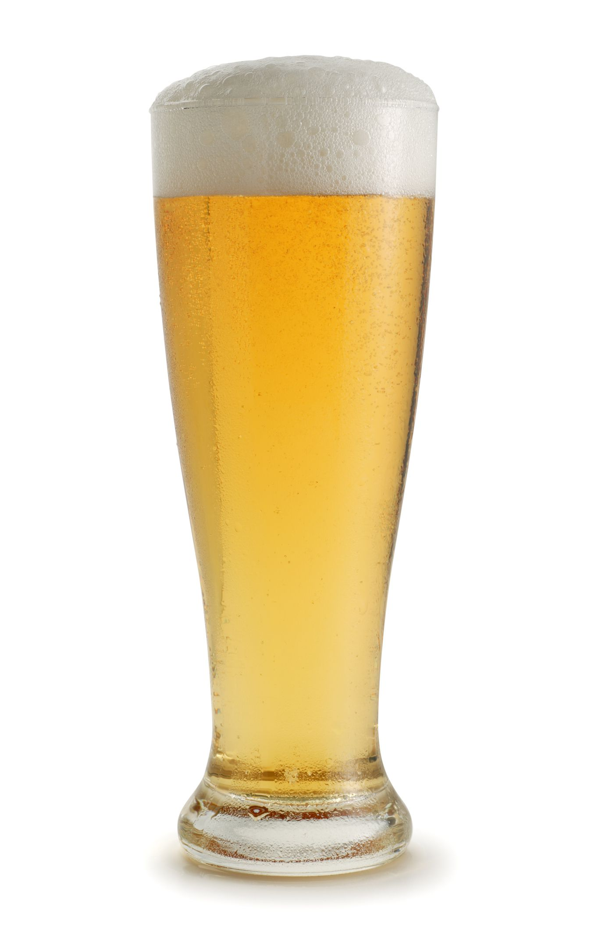
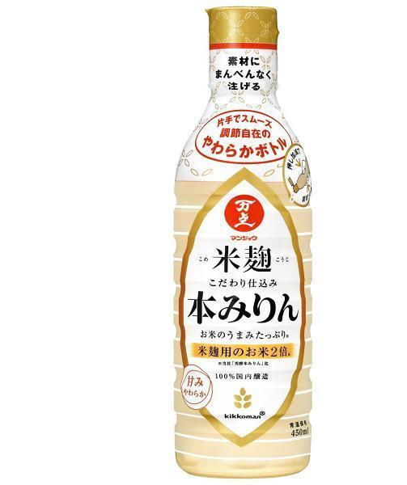
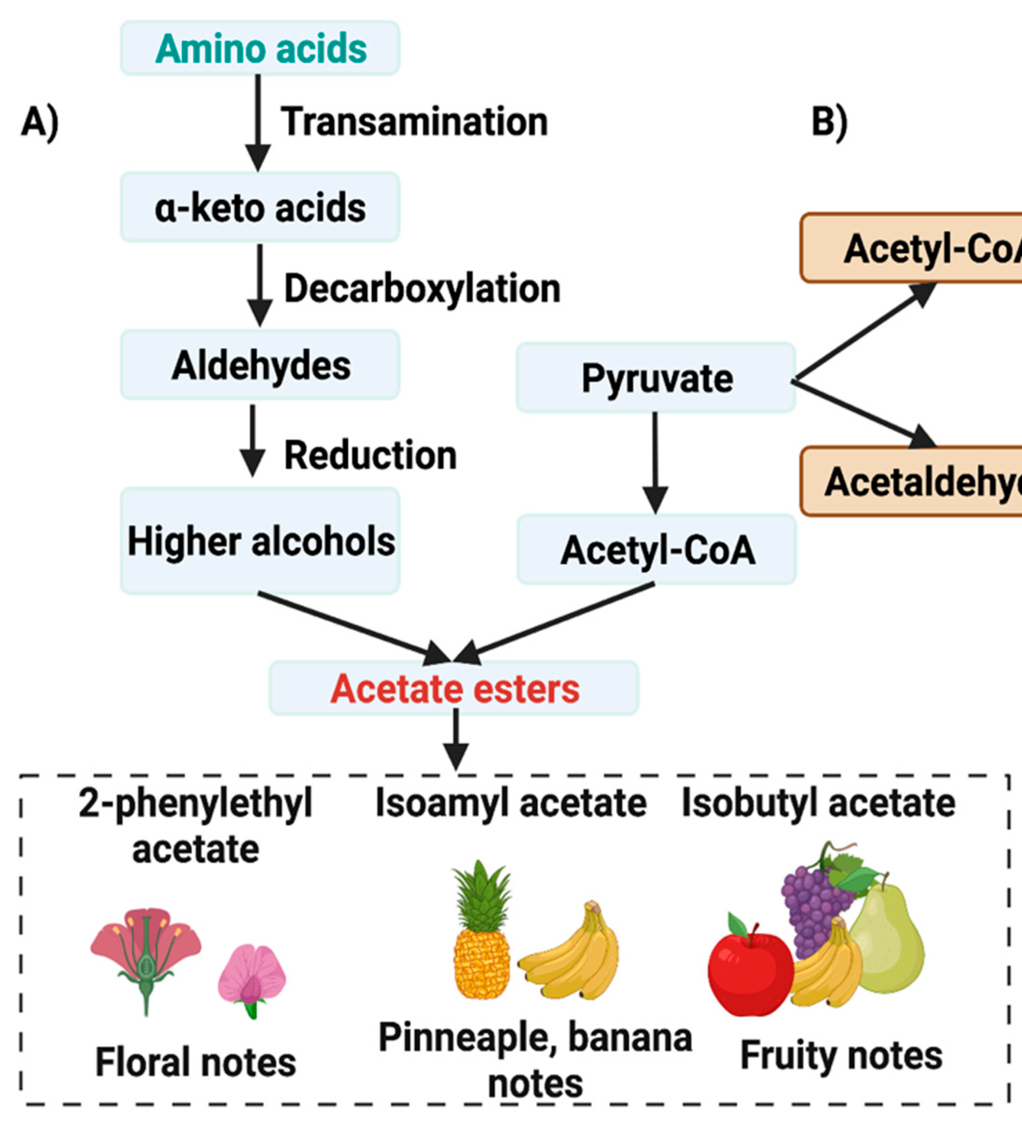
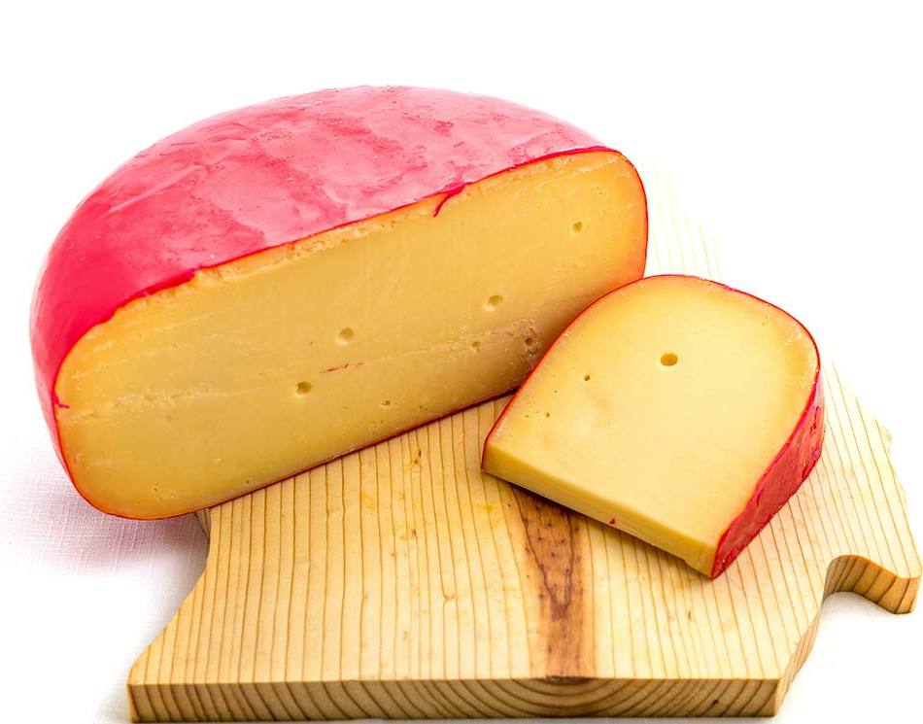
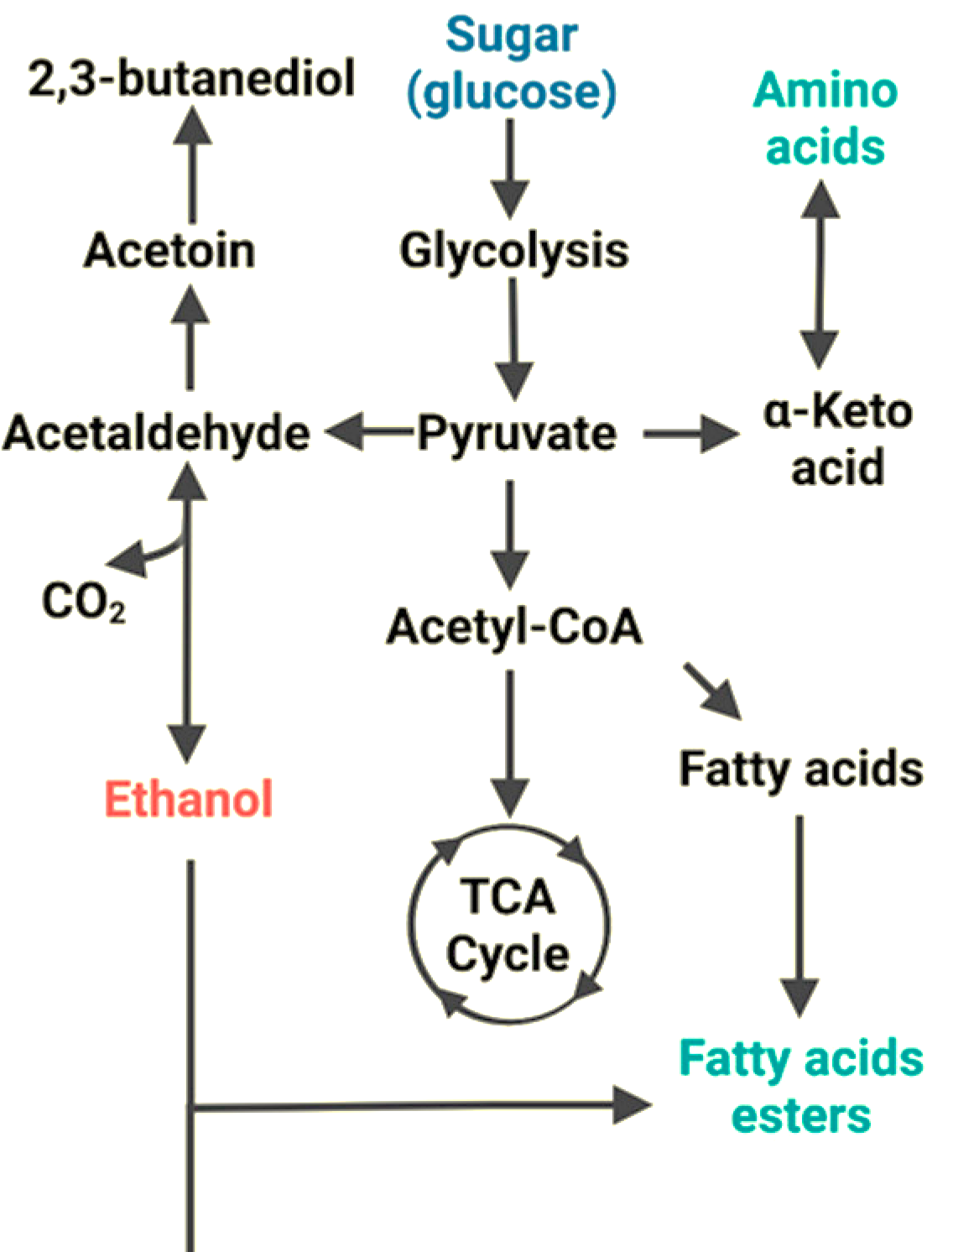
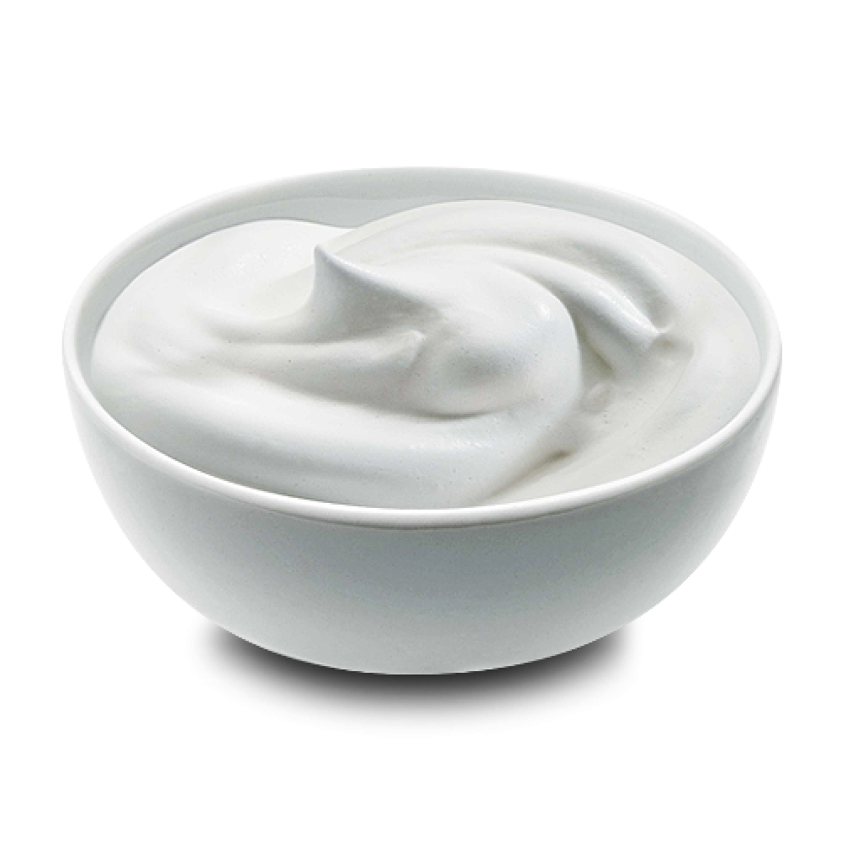
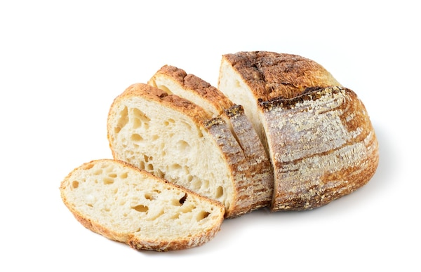
FERMENTED FOODS
Gutiérrez-Ríos et al. (2022)
WIN-WIN
Sugar metabolism
Inhibit pathogens, add flavor compounds
Protein metabolism
Notes:
Fermentation makes food taste better, but it is also an important method of preservation
Cheese, yogurt, wine are excellent ways to get calories from dairy and grain out of season

Slide 3
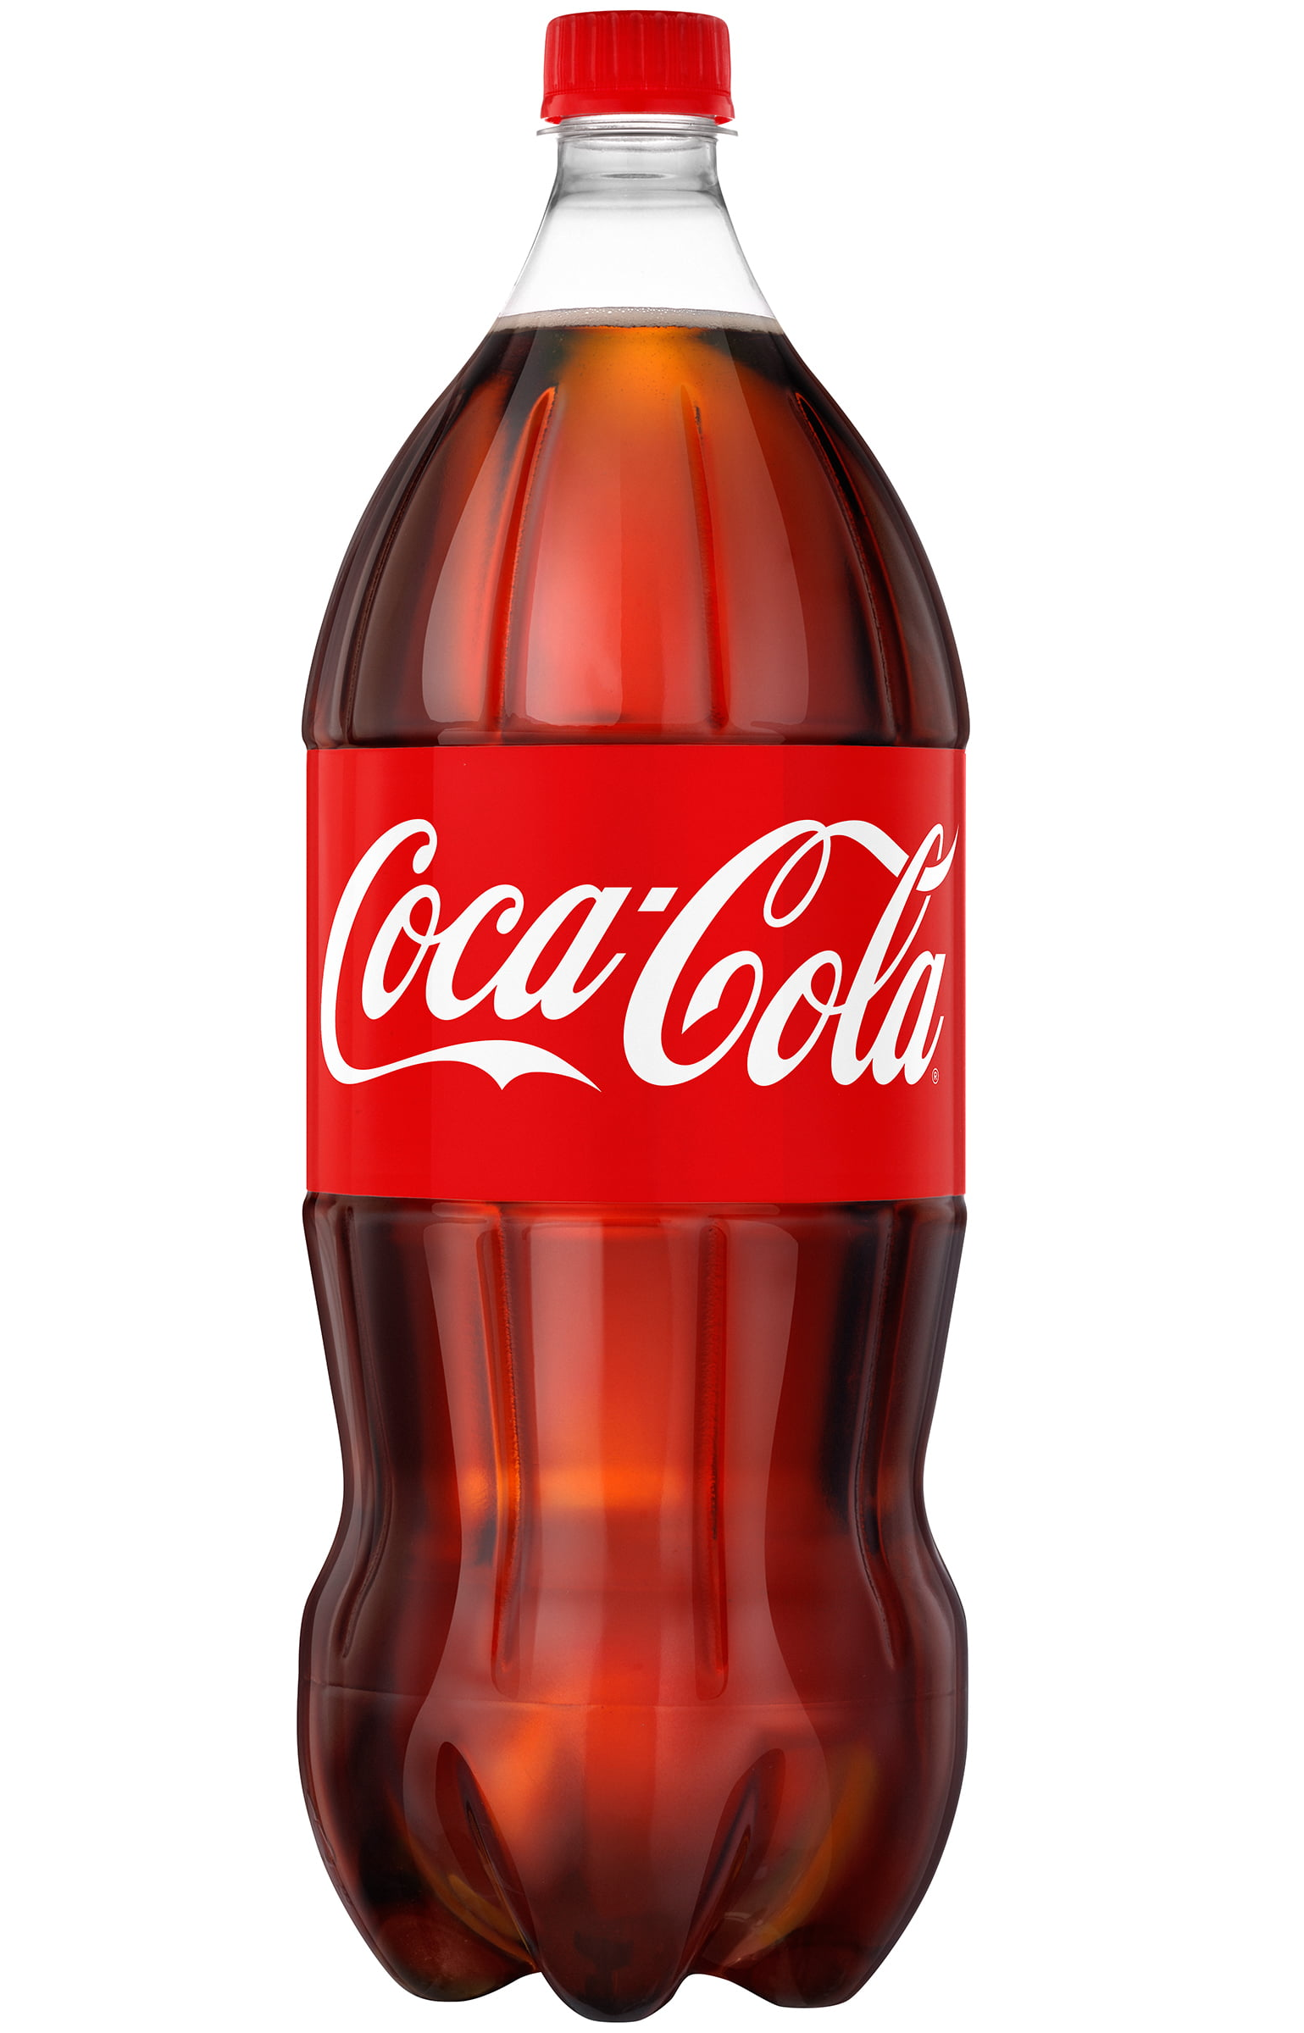
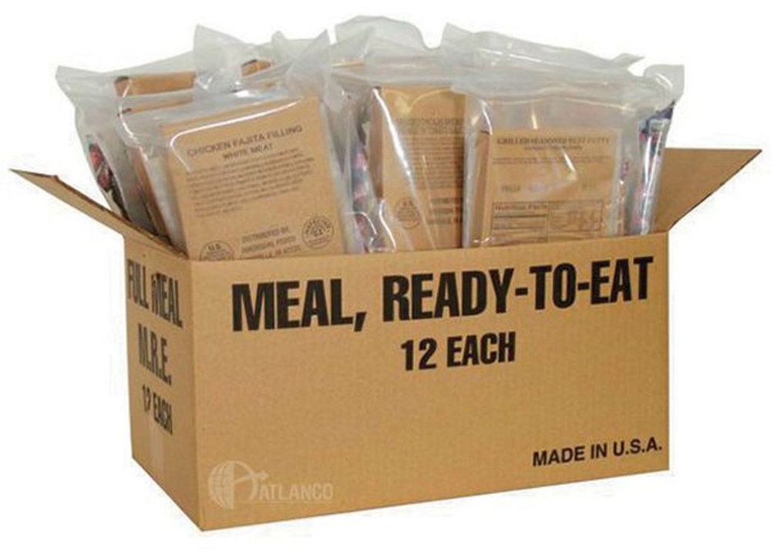
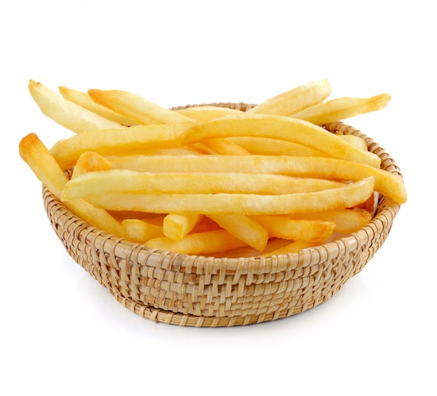
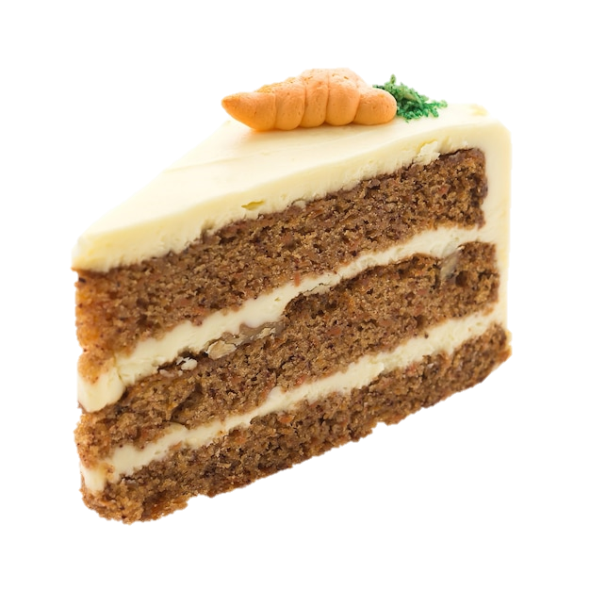
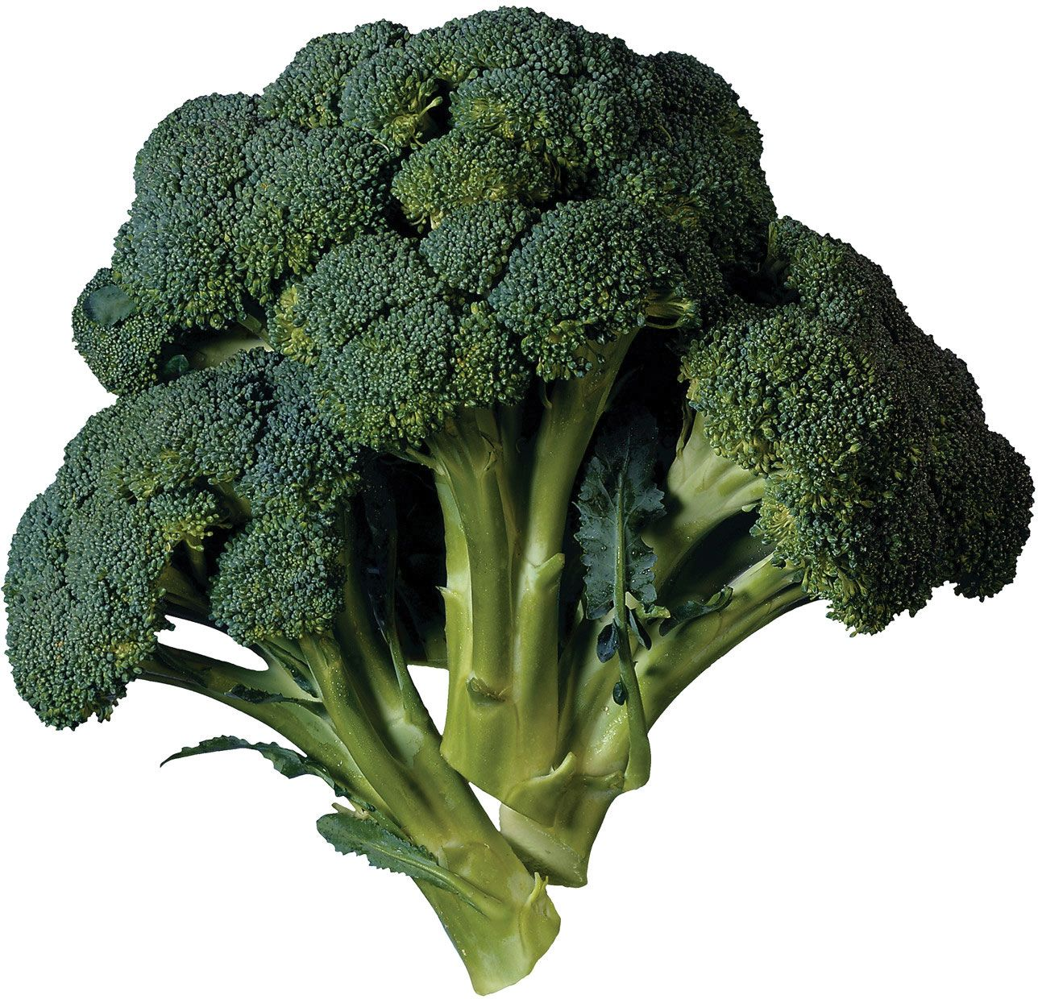
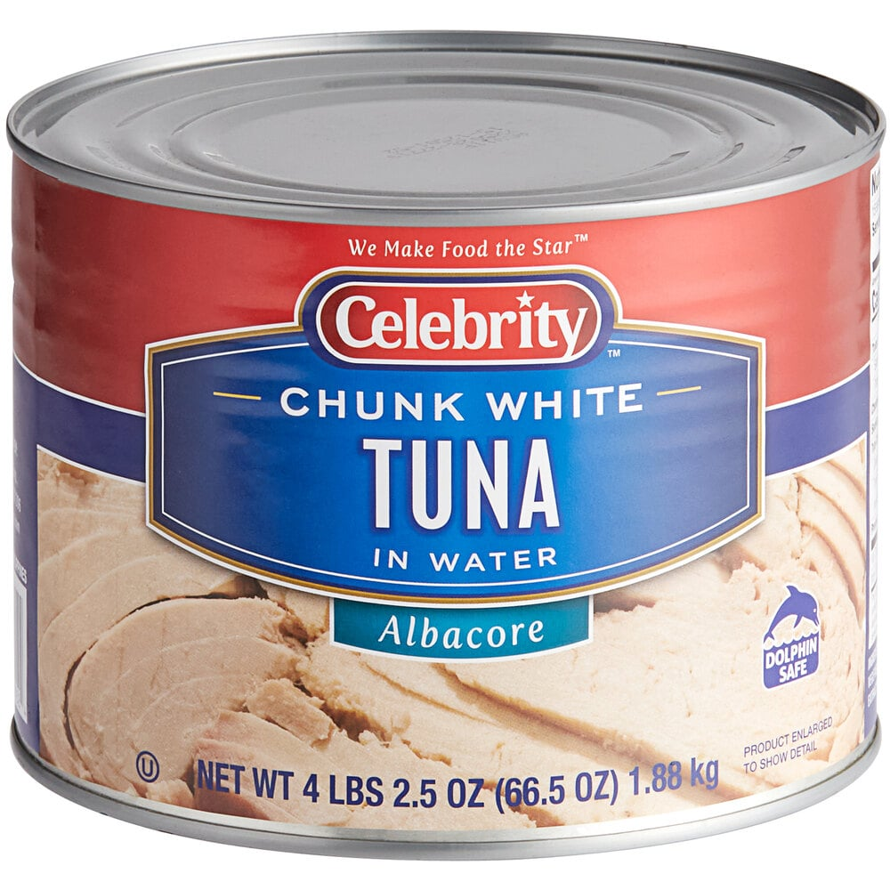
Utilitarian
Hedonic
• Nutritious
• Long-lasting
• Easy to prepare
Tastes good •

Slide 4
Utilitarian
Hedonic
FERMENTED FOODS
• Nutritious
• Long-lasting
• Easy to prepare
Tastes good •
WIN-WIN
Inhibit pathogens, add flavor compounds

Slide 5
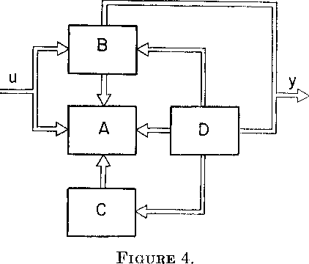
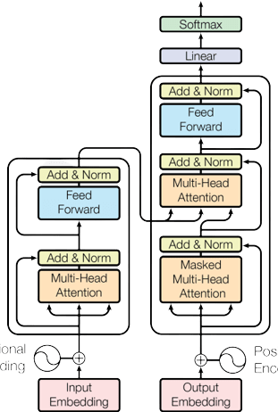
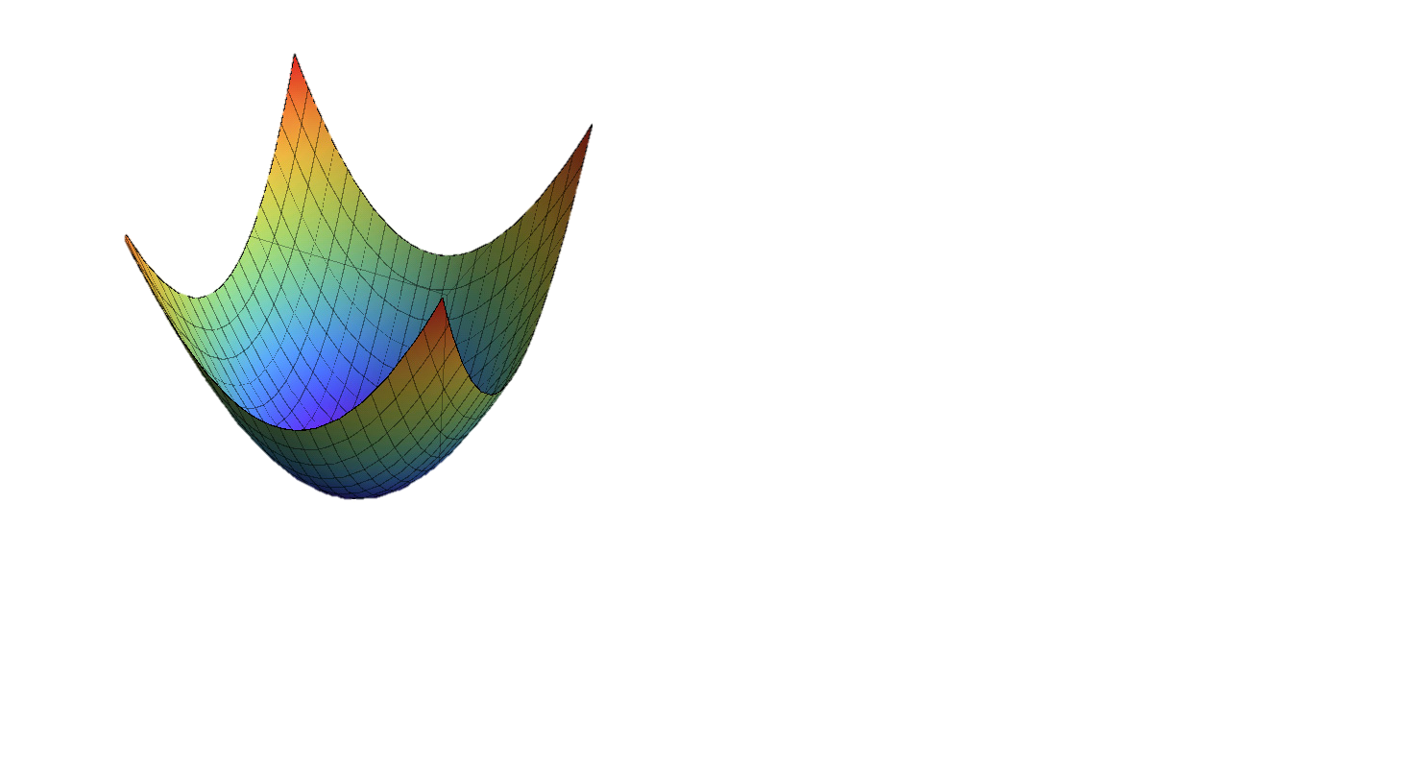
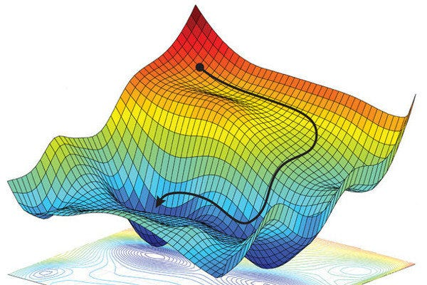
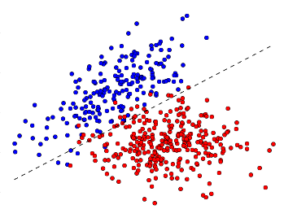

Classical
Modern
• Efficient
• Safe (reliable, robust, interpretable)
• Easy to analyze
Accurate •

Slide 6
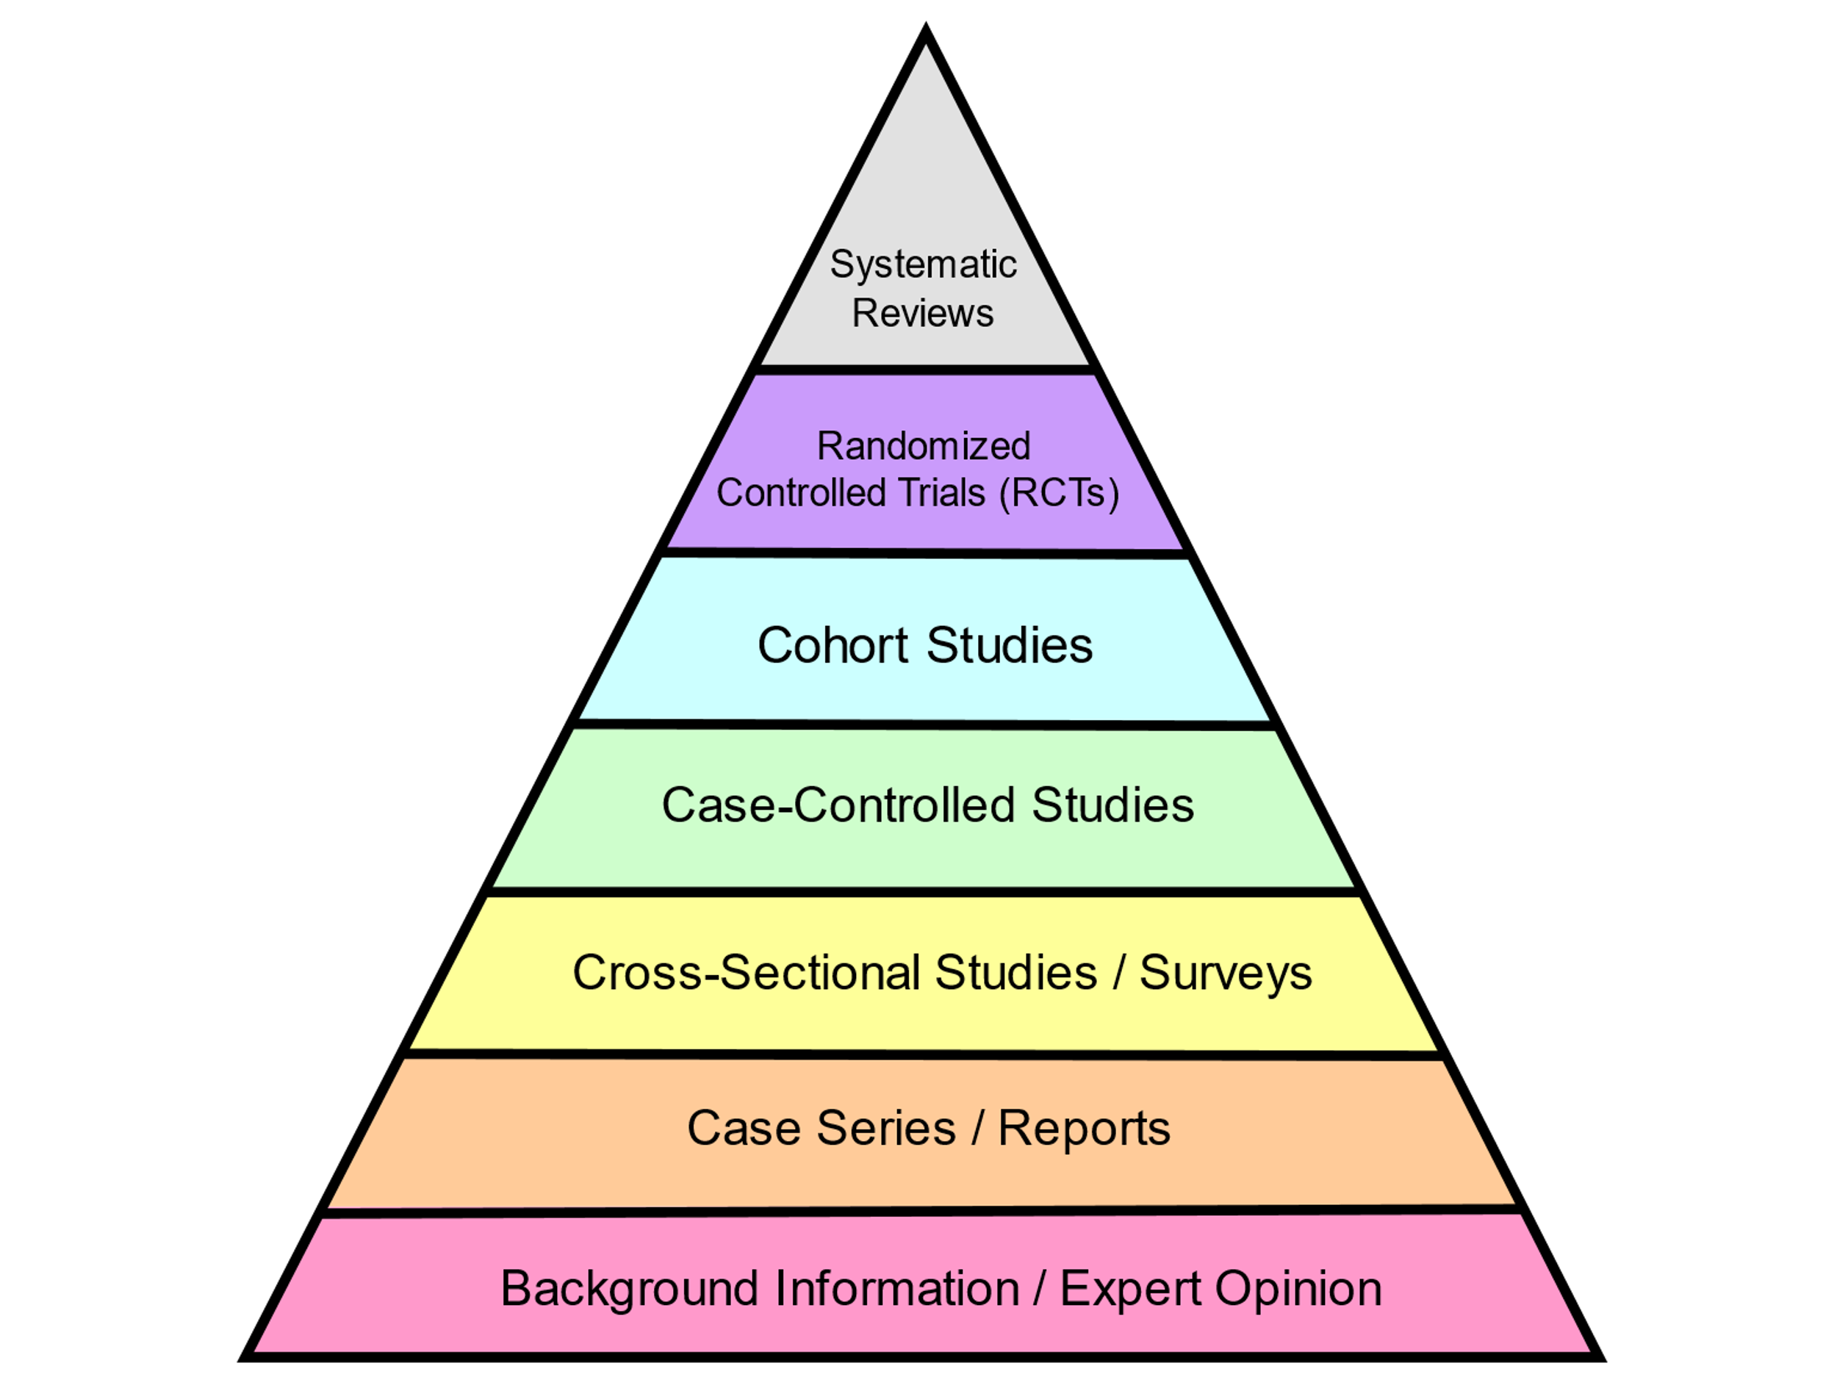
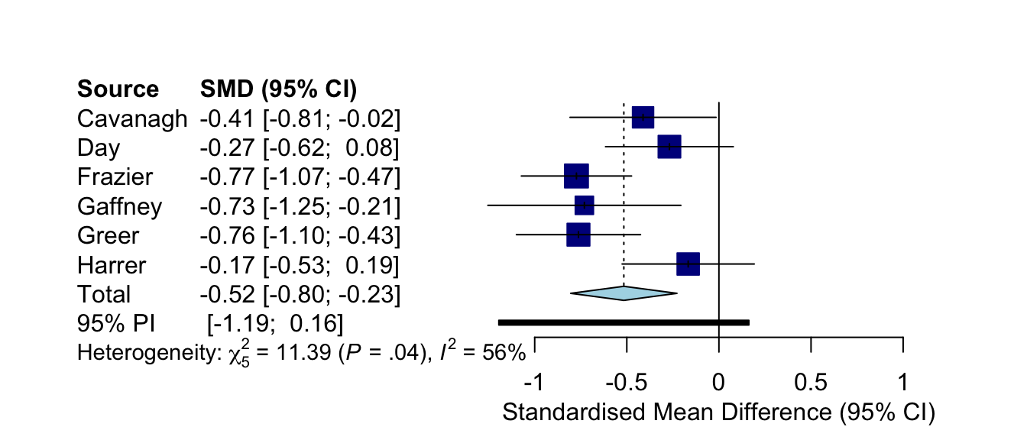
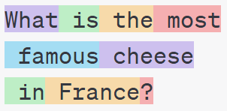
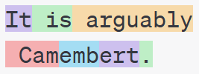
Classical
Modern
THIS TALK
• Efficient
• Safe (reliable, robust, interpretable)
• Easy to analyze
Accurate •
Syntheses between classical and modern machine learning
Meta-Analysis
Sequence Models
What are the mechanisms?
WIN-WIN

Slide 7
CLAIM
Meta-analysis is an interesting machine learning problem.
Use large datasets to dramatically improve causal inferences and patient outcomes
Scientific question-answering is an interesting unsolved problem for LLMs
A beautiful statistical problem which exposes key challenges in uncertainty quantification

Slide 8
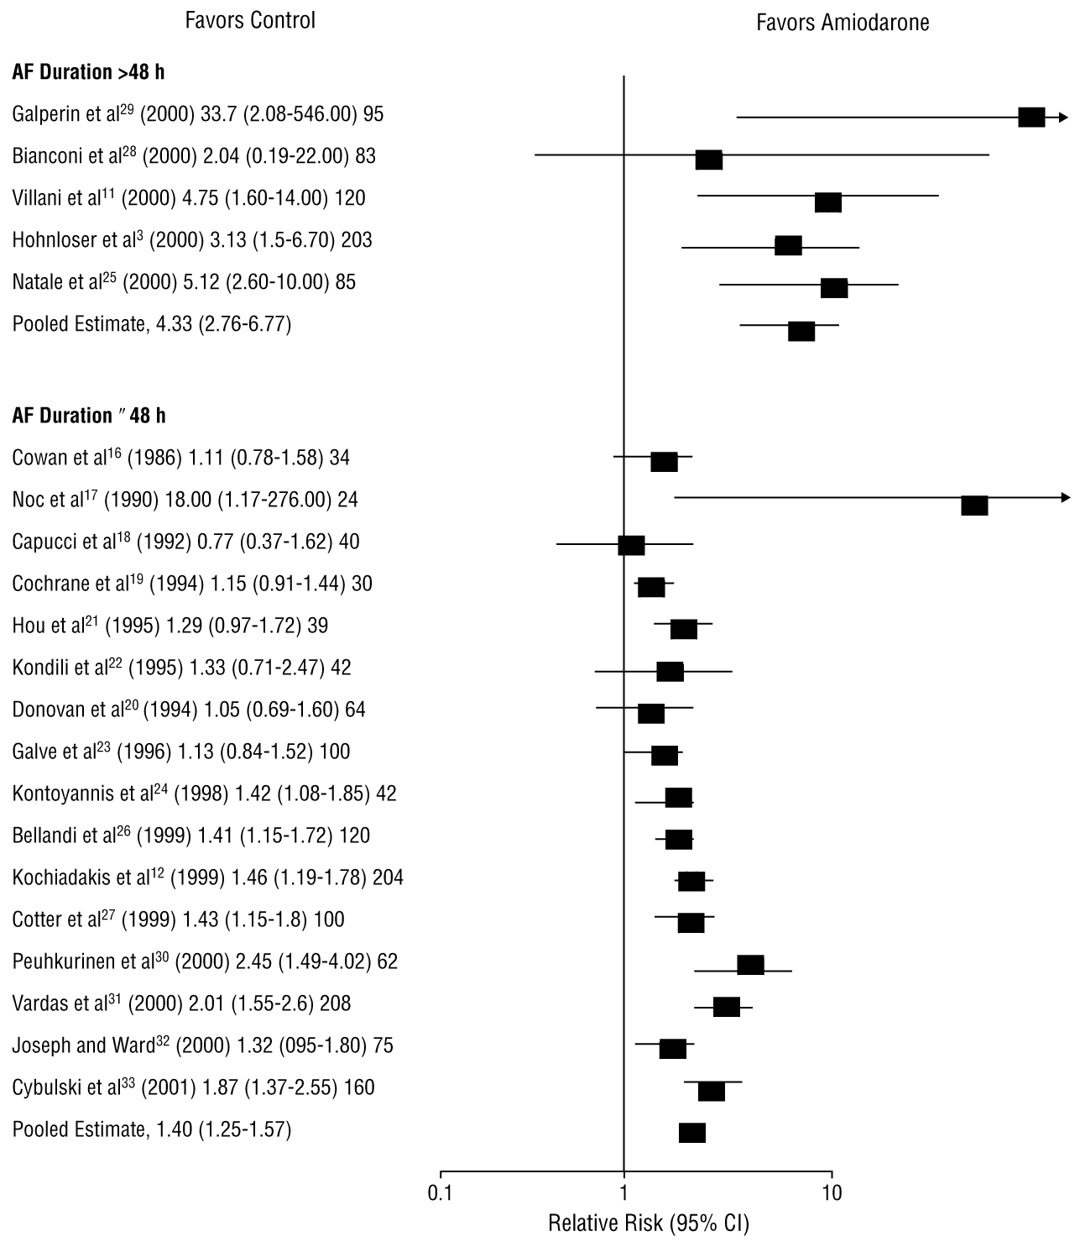
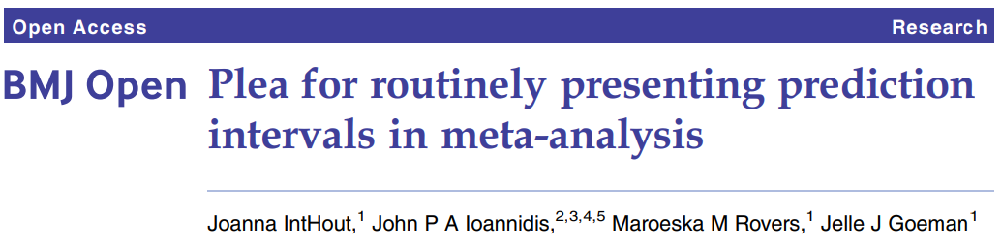
Meta-Analysis
Letelier et al. (2003)
Effect
Observed effect
[Future]
95% CI
95% PI for y
95% PI for u

Slide 9
Meta-Analysis
Features
Effect
Variance
Observed effect
1-α PI for y
1-α PI for u

Slide 10

How effectively does amiodarone restore normal sinus rhythm to patients with atrial fibrillation?
causal inference
no causal inference
(without assumptions)

Slide 11
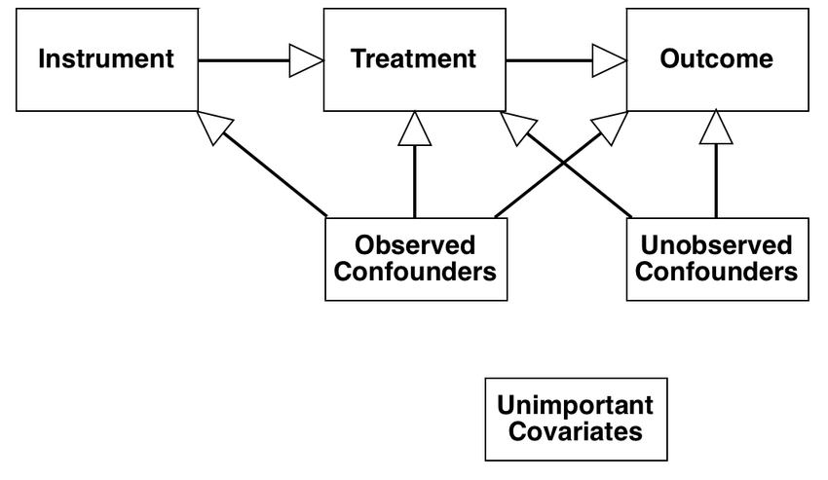
Trusted data
Untrusted data
• Rigorous and unbiased
• Loose predictions
Need strong assumptions •
Tight predictions •

Slide 12
Trusted data
Untrusted data
CONFORMAL META-ANALYSIS
• Rigorous and unbiased
• Loose predictions
Need strong assumptions •
Tight predictions •
CONFORMAL
META-ANALYSIS
trusted data
untrusted data
WIN-WIN
Assumption-free inclusion of untrusted prior

Slide 13
Conformal Prediction
……
…
Past
has residual
exchangeable, so rank of r* is uniform among R_{i}
Future
has residual
(Hypothetical) Future
has residual

Slide 14
train on everything for exchangeability
Prior
Posterior
Residuals
[Future]
90% PI for y
??????????????????
?

Slide 15
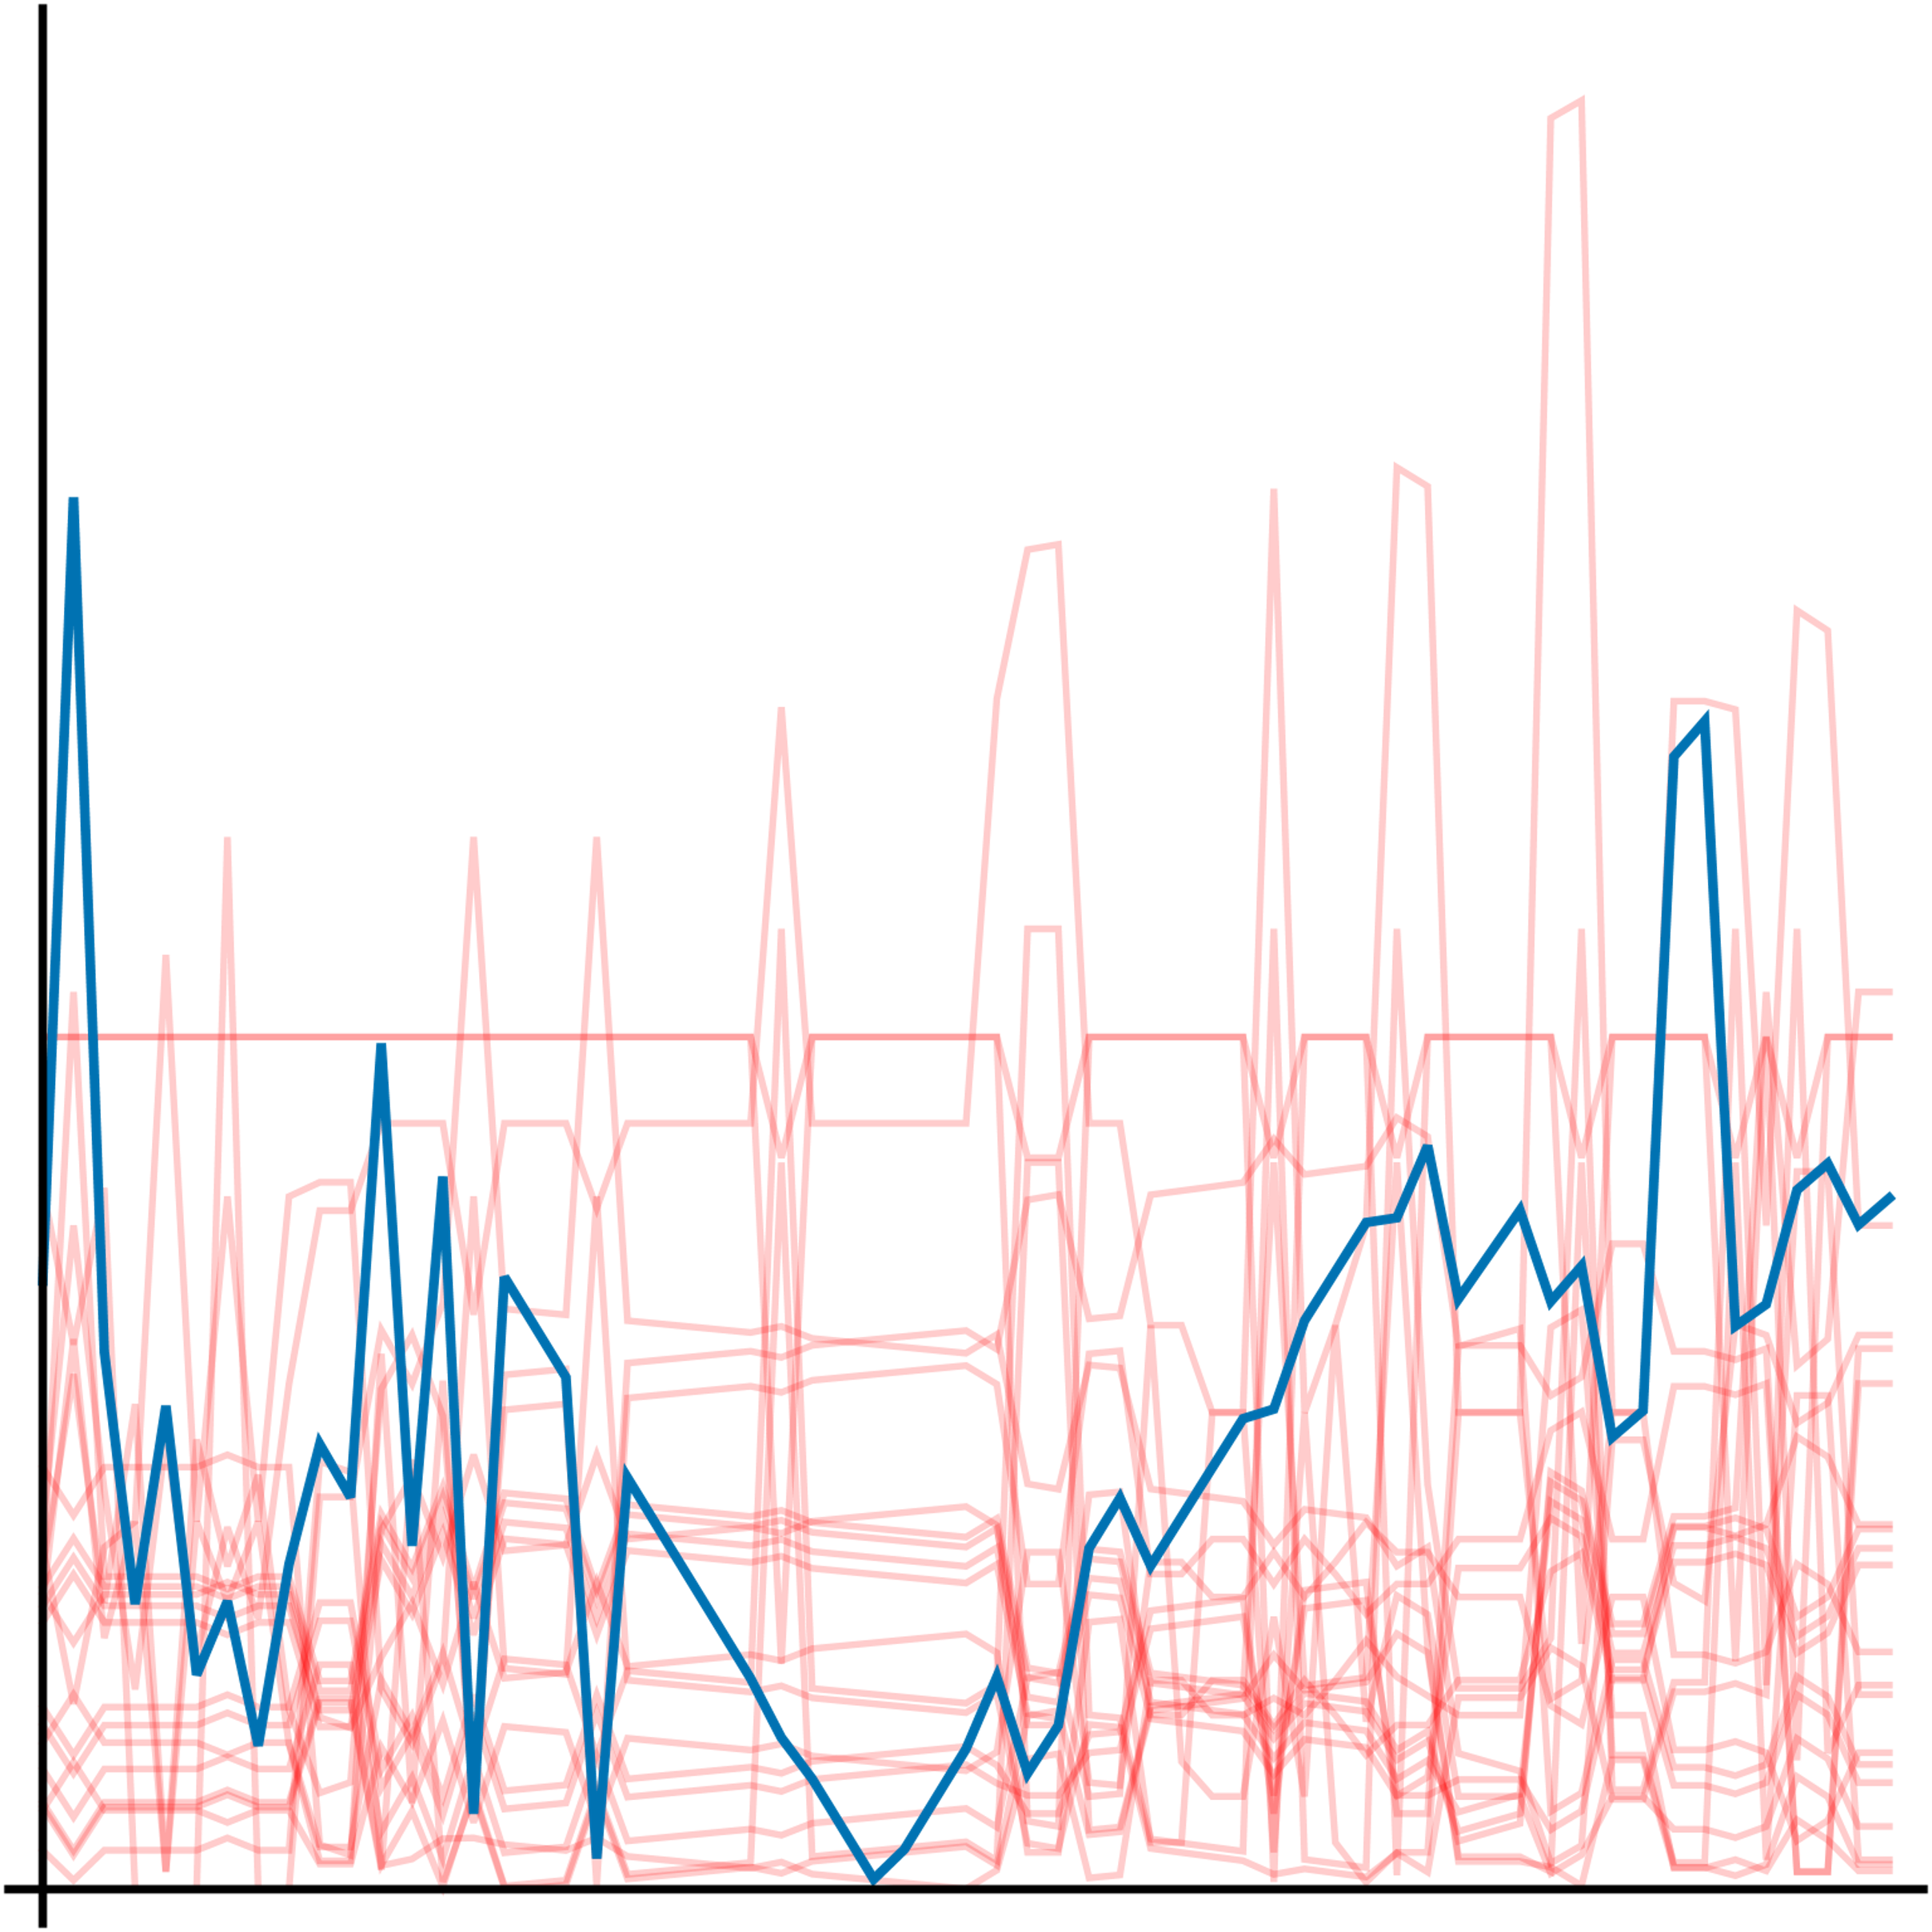
train on everything for exchangeability
Prior
Posterior
Residuals
Residuals
[Future]
90% PI for y
??????????????????
?

Slide 16
CHALLENGES
1. Full conformal prediction is intractable
1. (n is small, so cannot split the data)
2. Also want interval for u, not just y = N(u,v)
Kaul and Gordon (2024)

Slide 17
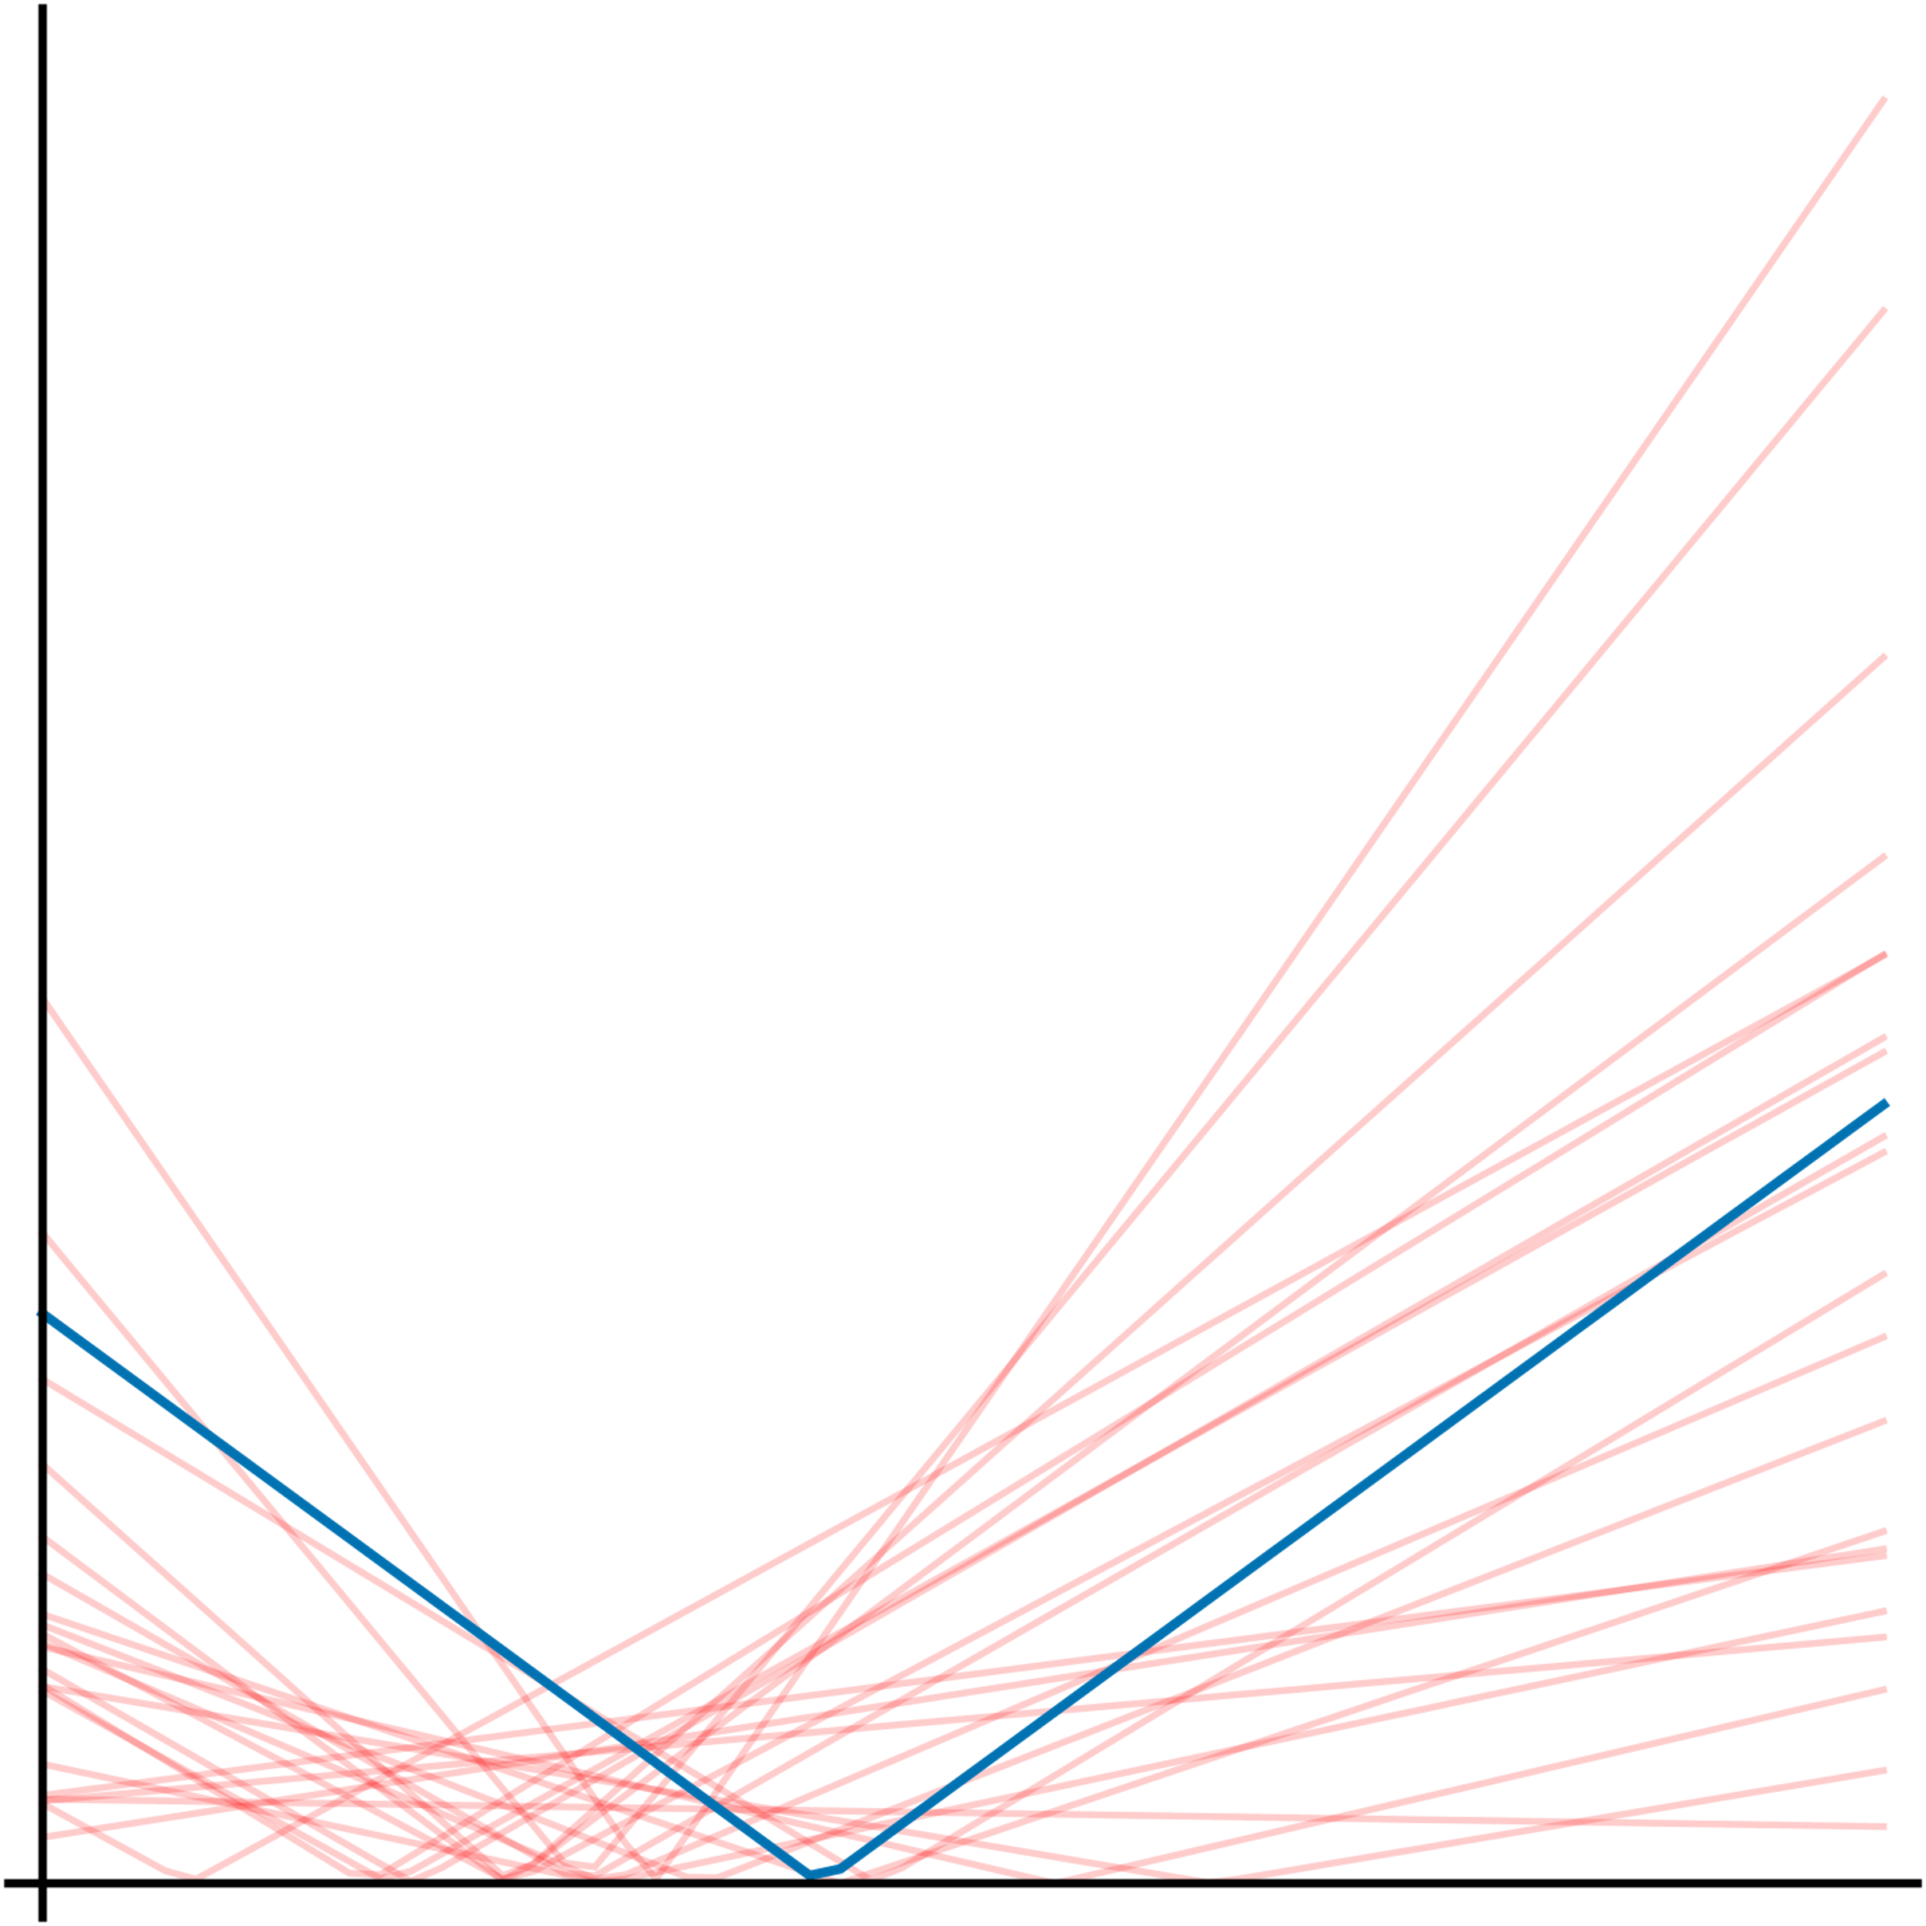
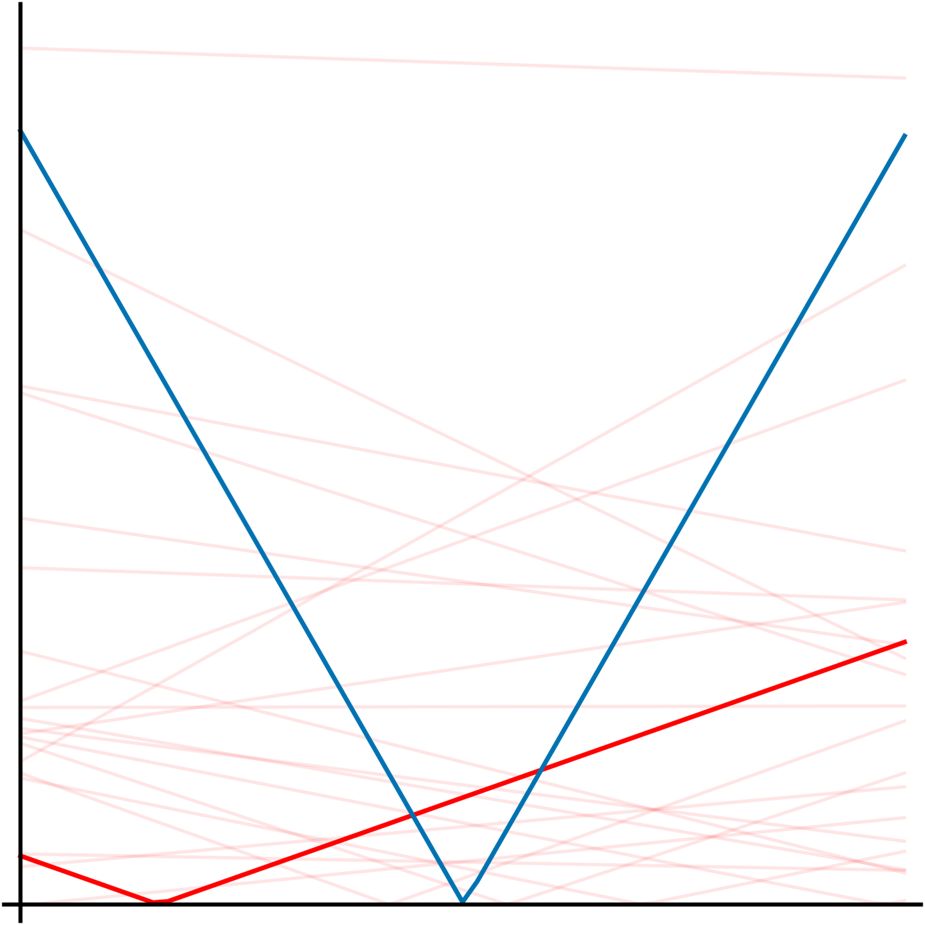
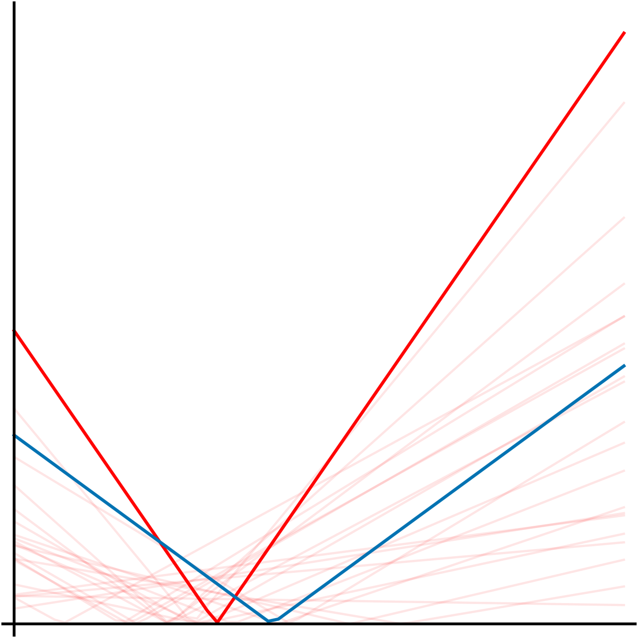
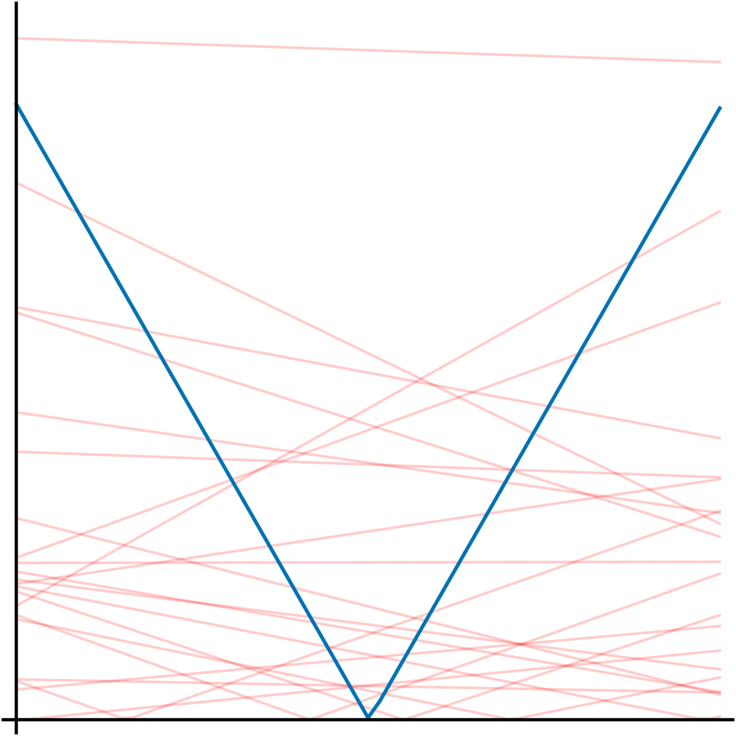
disjoint in y
if and only if
Focus on linear smoothers
like kernel ridge regression (KRR)
residuals are convex in y
Ensure idiocentricity
changing y affects r more than any R_{i}
for linear smoothers
easy to ensure for KRR
*Tolerate approximation

Slide 18
CHALLENGES
1. Full conformal prediction is intractable
1. …but not for idiocentric linear smoothers.
2. Also want interval for u, not just y = N(u,v)
Kaul and Gordon (2024)

Slide 19
independent
CONFORMAL
CONFORMAL
VS

Slide 20
Exploit independence of noise
Idiocentricity tightly bound outer interval

Slide 21
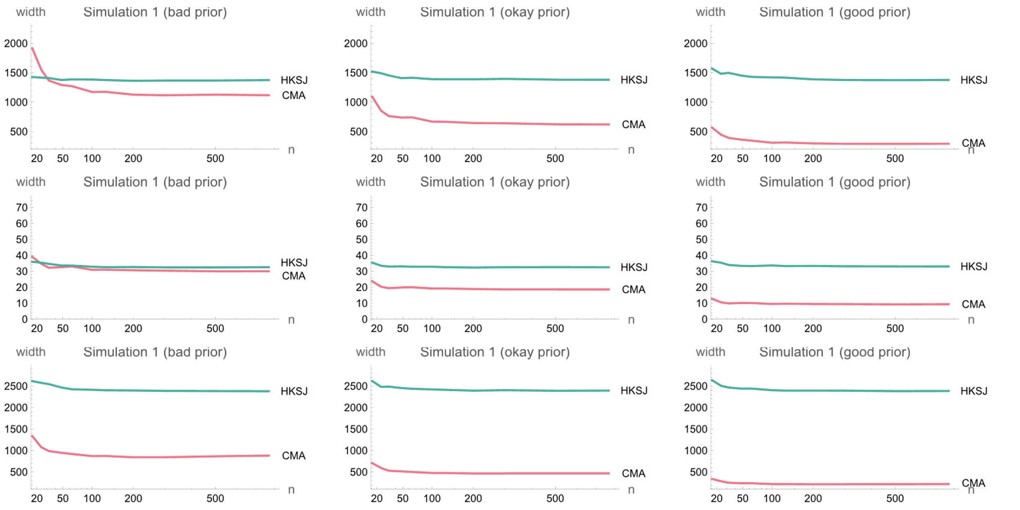

Slide 22
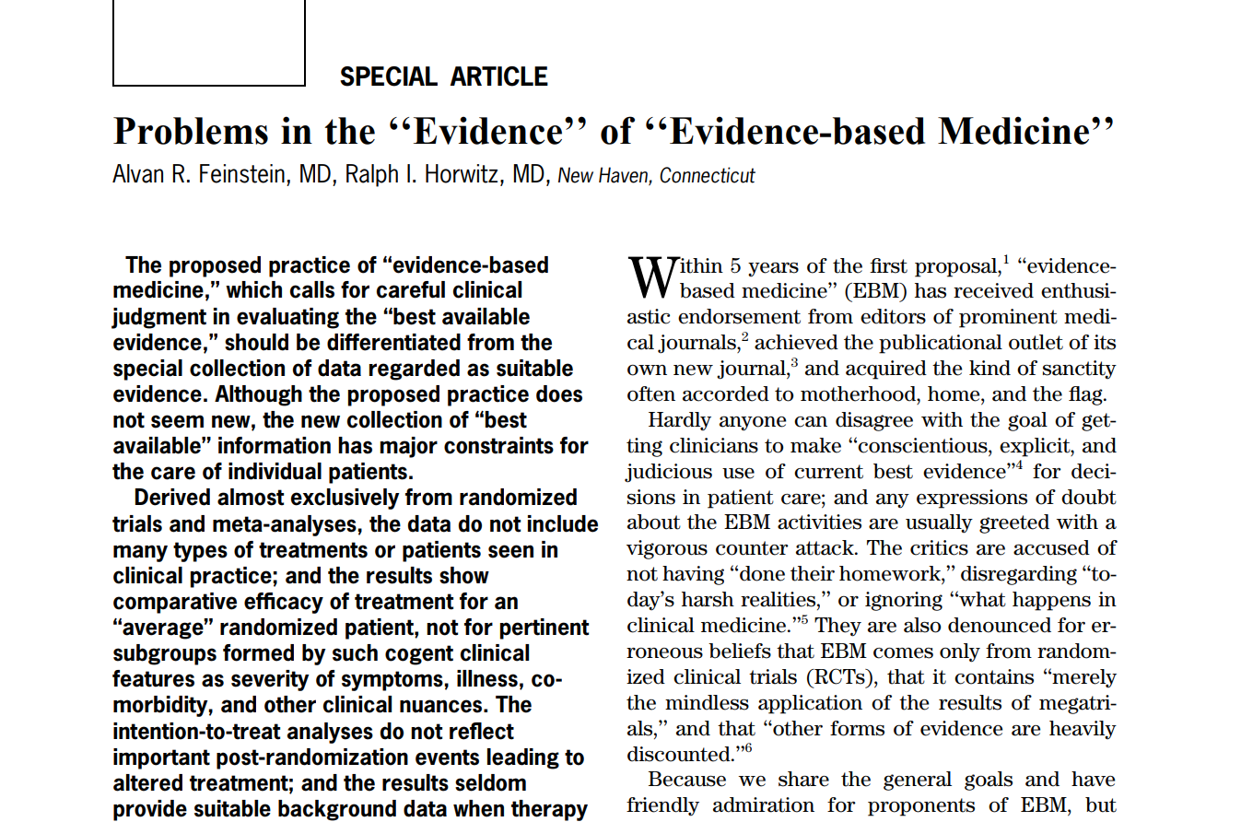
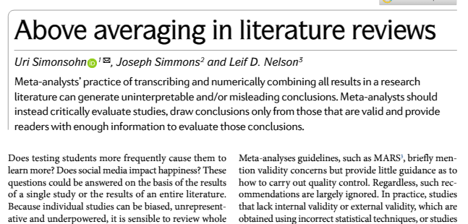
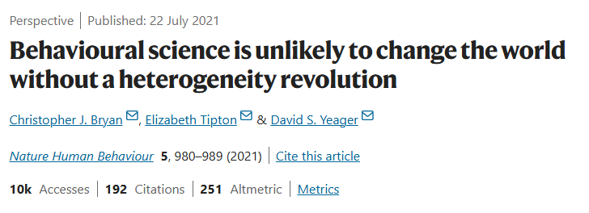
CONTRIBUTIONS
Formulated meta-analysis as an interesting machine learning problem
Simplified full conformal prediction for idiocentric linear smoothers
Addressed statistical/algorithmic challenges in handling noise

Slide 23
THIS TALK
Meta-Analysis
Sequence Models

Slide 24
Linear
Nonlinear
• Efficient (O(T) memory) and
• Fast (O(log T) parallel time via scans)
• Unexpressive
Inefficient (O(T²) memory) or •
Slow (O(T) parallel time) •
Expressive •
Attention
(Time-varying) Linear dynamical system
Recurrent neural network

Slide 25
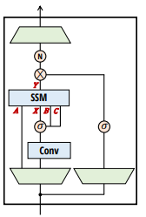
Linear
Nonlinear
STATE-SPACE MODELS
• Efficient (O(T) memory) and
• Fast (O(log T) parallel time via scans)
• Unexpressive
Inefficient (O(T²) memory) or •
Slow (O(T) parallel time) •
Expressive •
INTERSPERSED NONLINEARITIES
Mamba and Mamba-2 [Dao and Gu, 2024]
WIN-WIN
Linear (i.e. efficient) across time, nonlinear along depth
Attention
(Time-varying) Linear dynamical system
Recurrent neural network

Slide 26
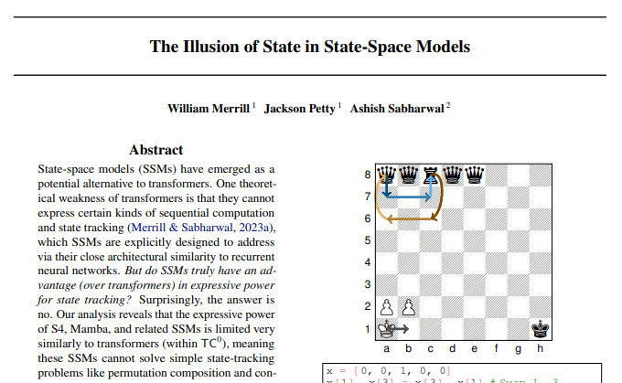
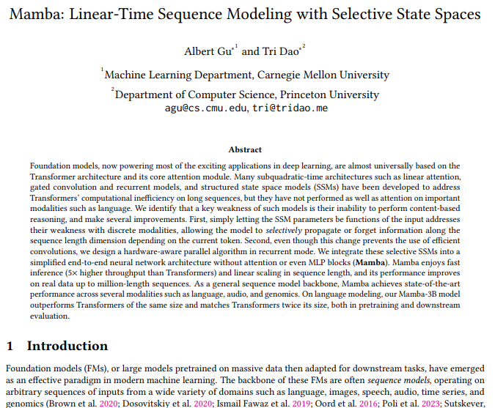
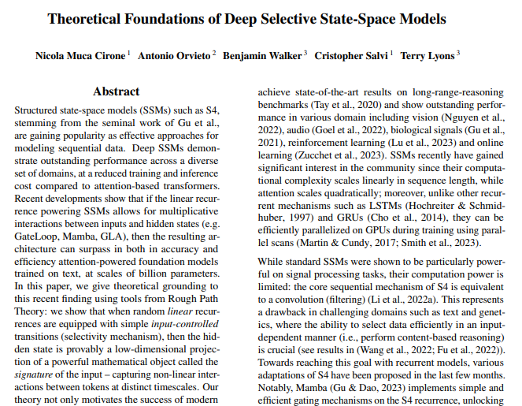
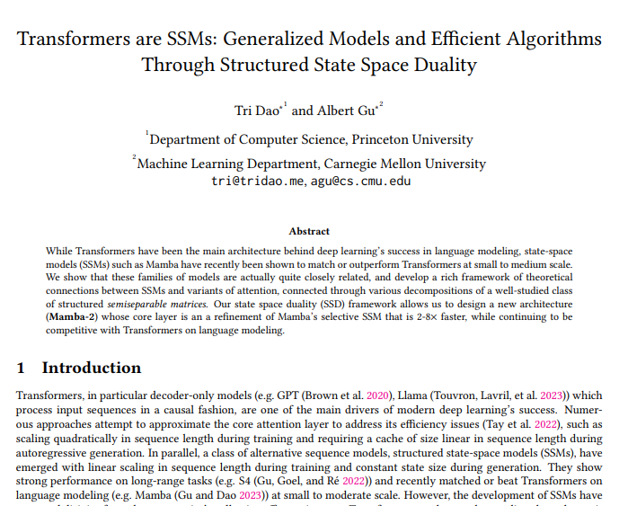
Nonlinearity across time
along depth
via iterated local corrections
[Kaul 2020]
Goal: approximate nonlinear RNN by a stack of linear systems, with nonlinearity along only depth
Theory: understand power of depth
Practice: use within new models

Slide 27
Nonlinearity across time
along depth
ASSUMPTION
via iterated local corrections
[Kaul 2020]
If a state is correct…
Then its next-state multiplier is correct…
So, in the next layer, the next state becomes correct.

Slide 28
Nonlinearity across time
along depth
ASSUMPTION
via iterated local corrections
[Kaul 2020]
If a state is correct…
Then its next-state multiplier is correct…
So, in the next layer, the next state becomes correct.

Slide 29
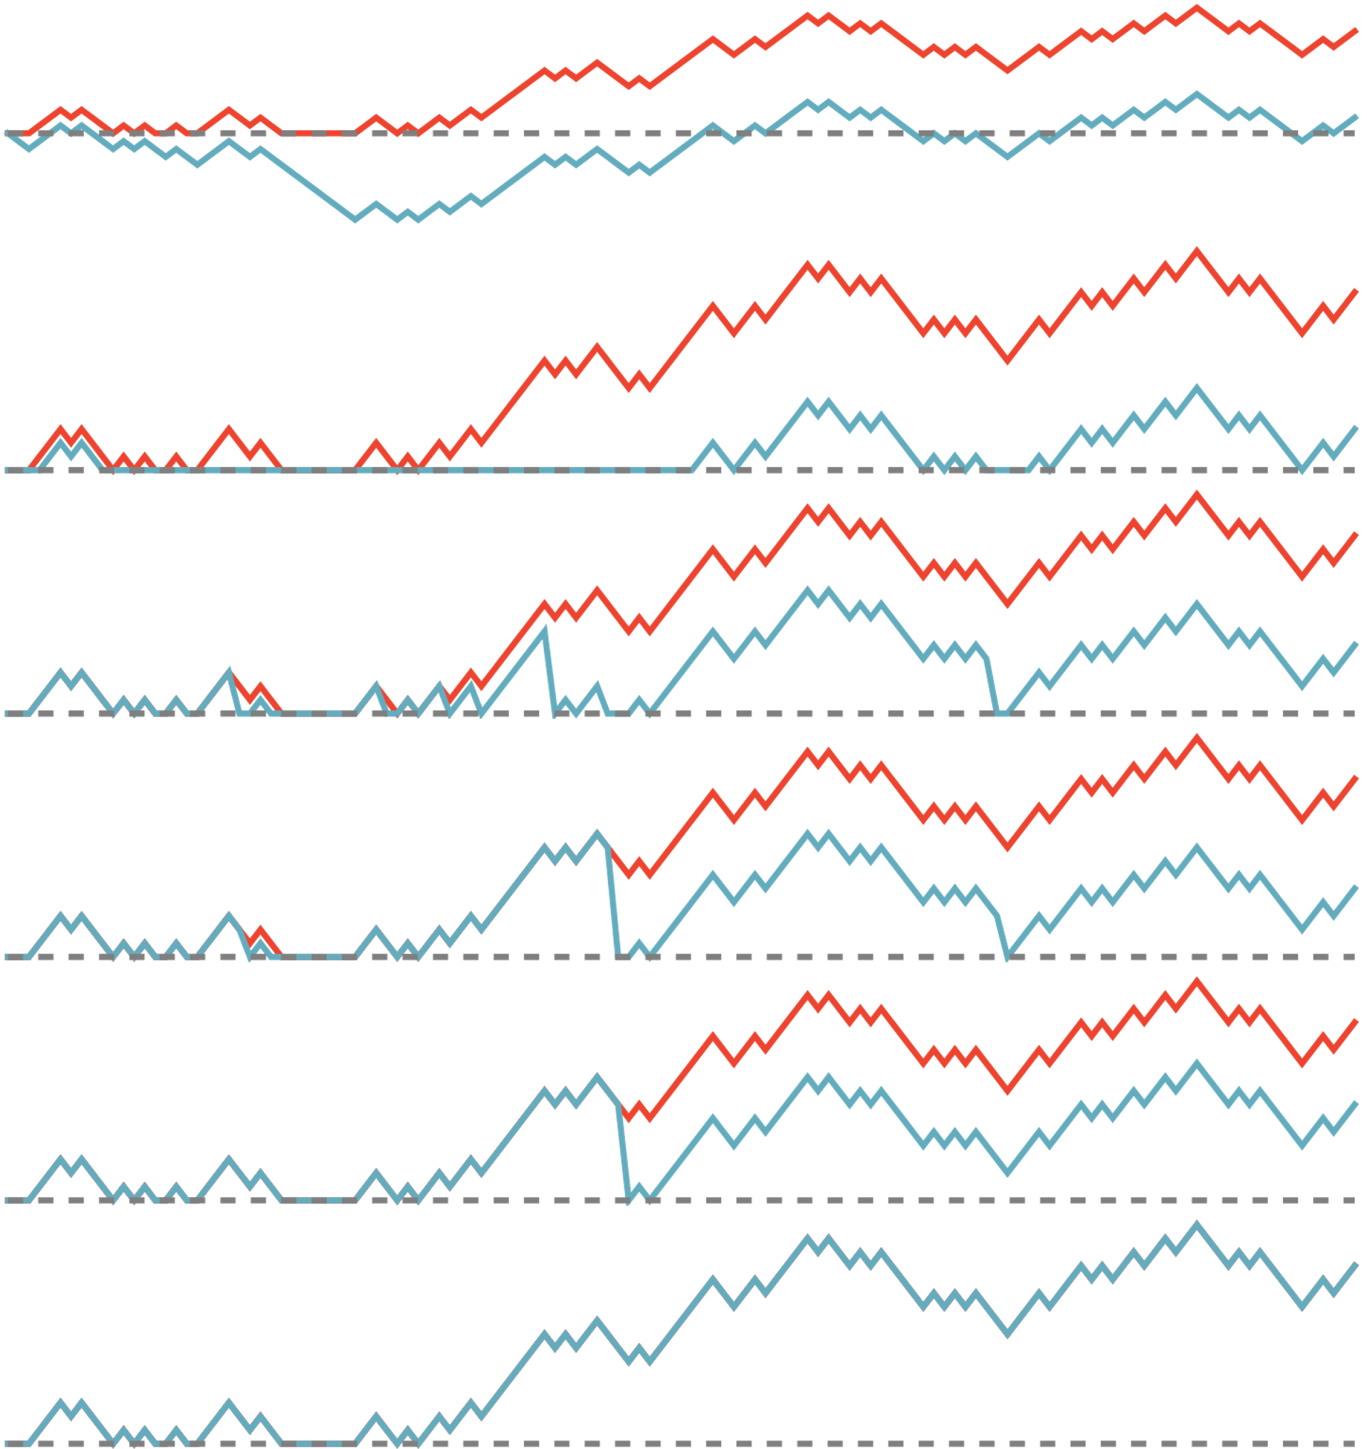

Slide 30
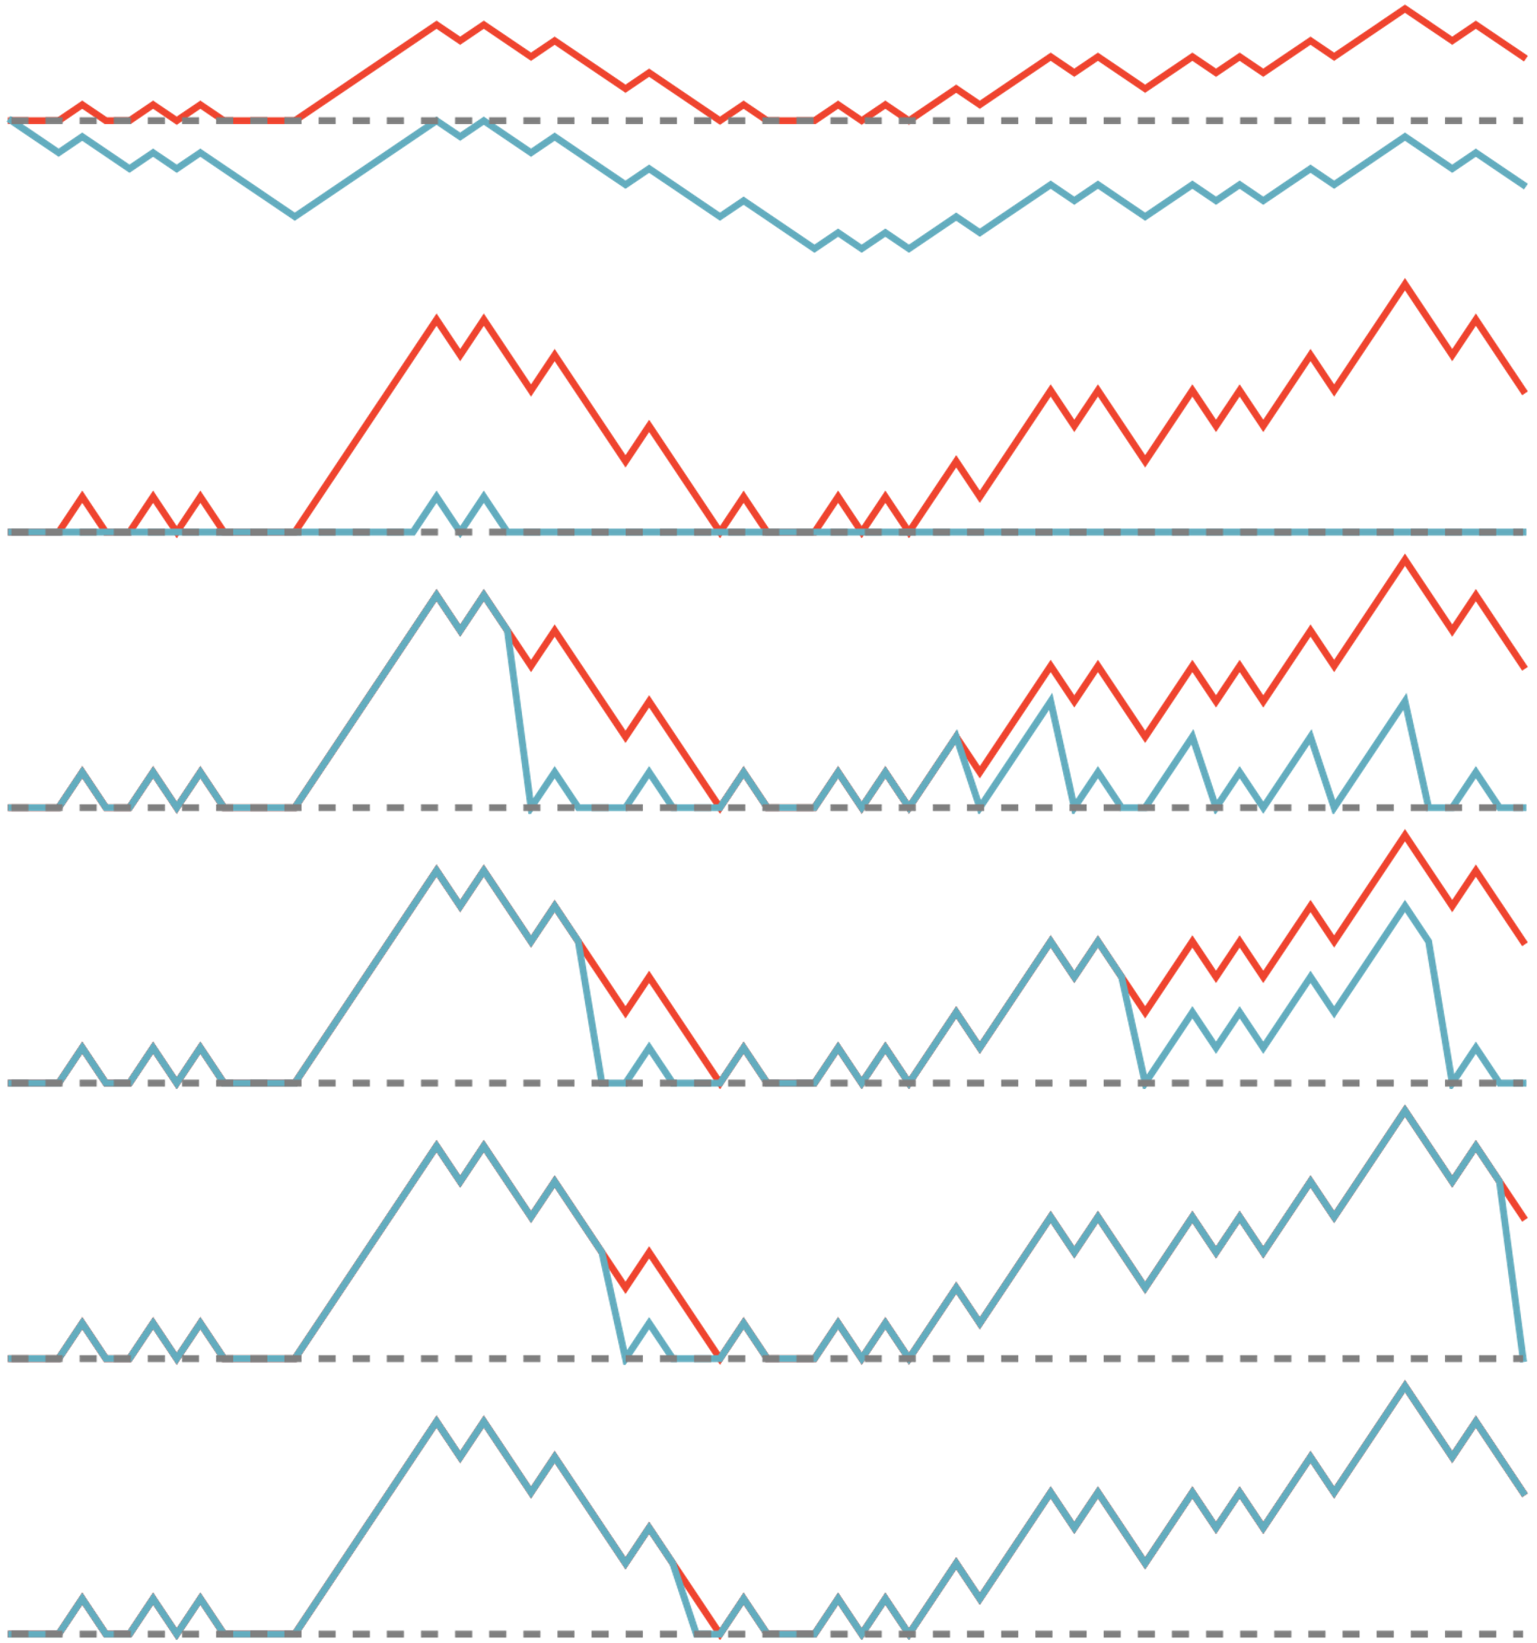

Slide 31
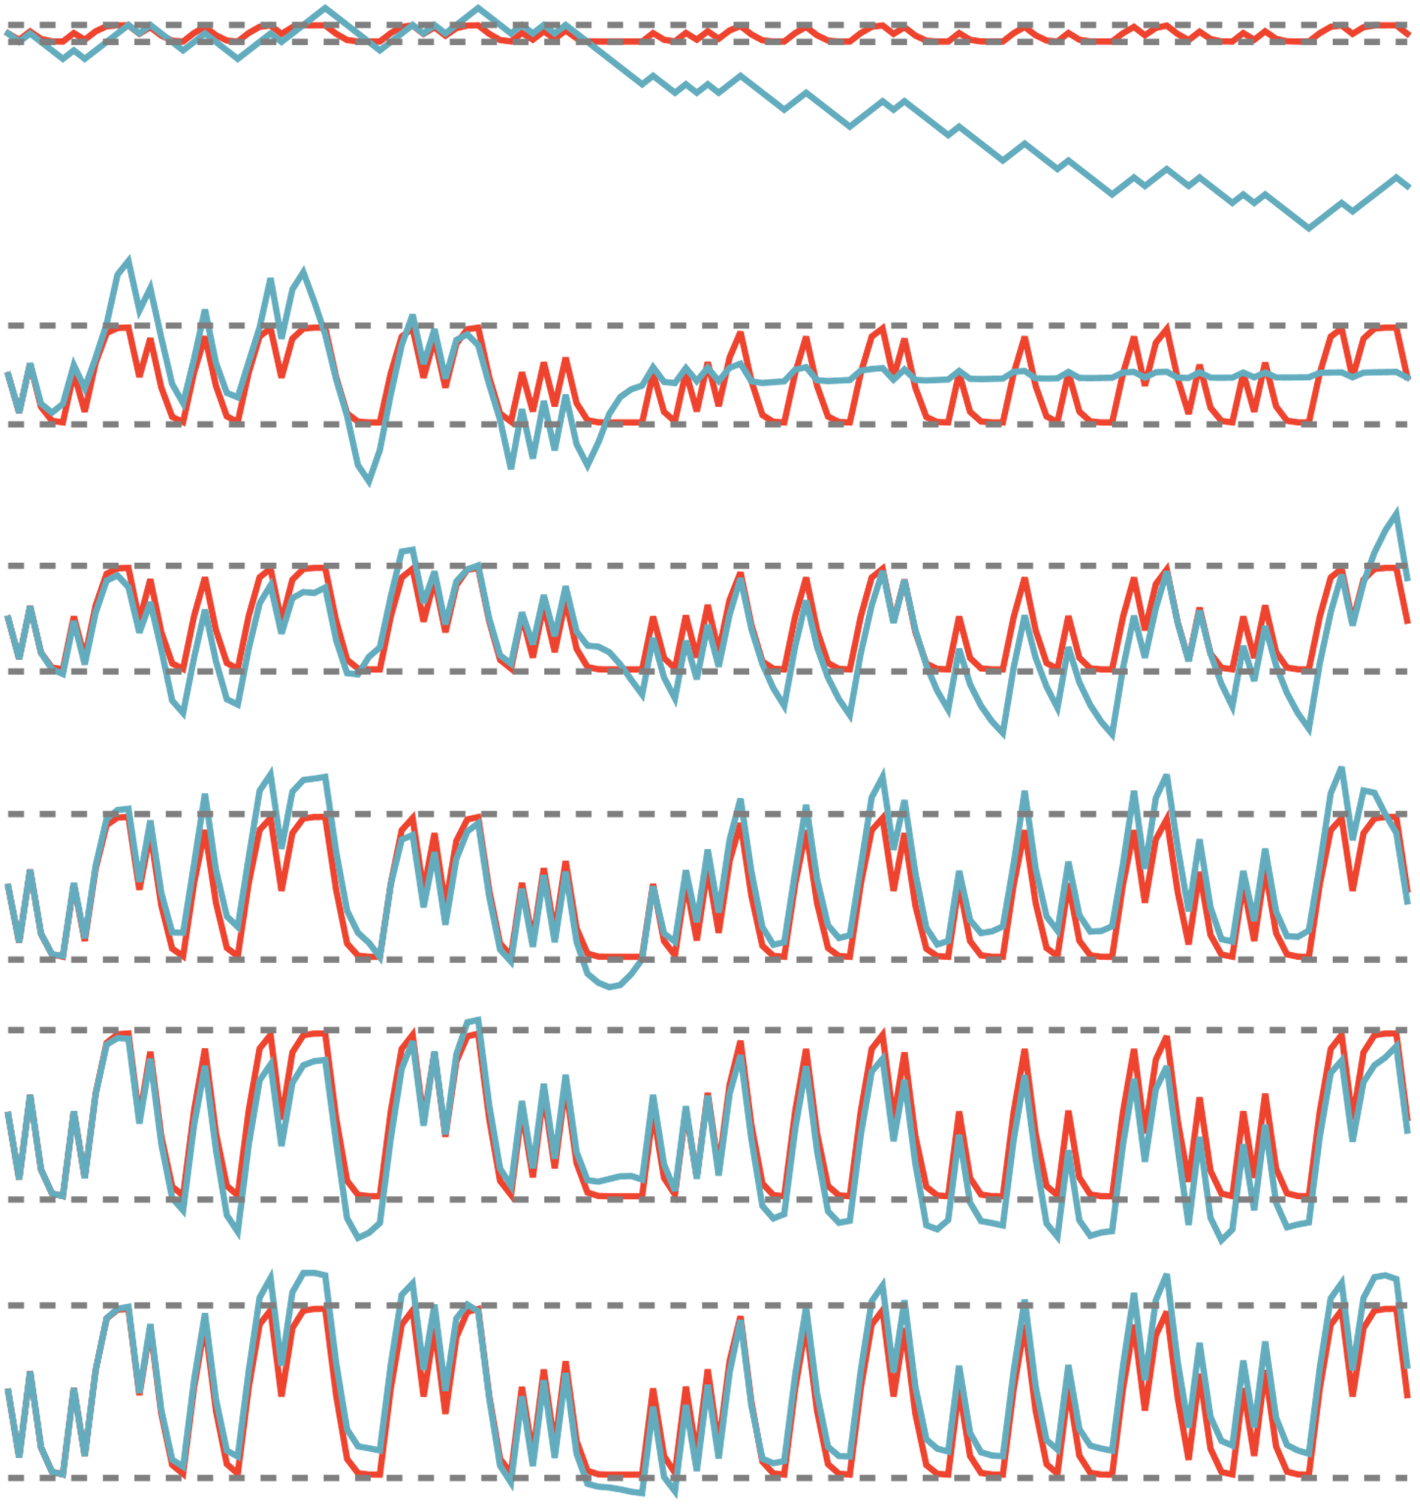

Slide 32
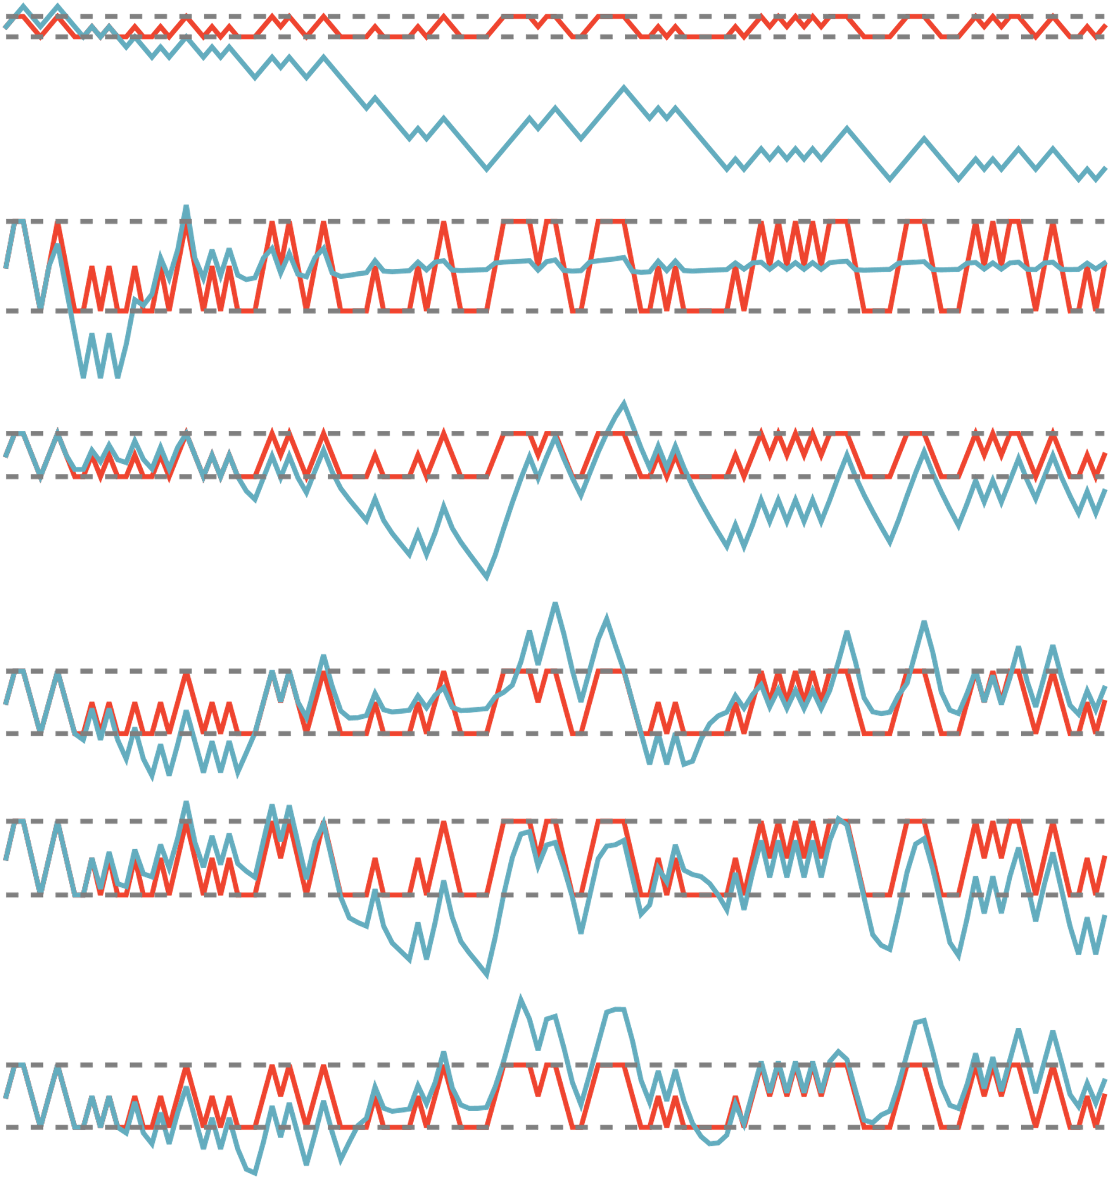

Slide 33
