Slide 1
Trusting Modern
Machine Learning
Shiva Kaul <skkaul@cs.cmu.edu>

Slide 2
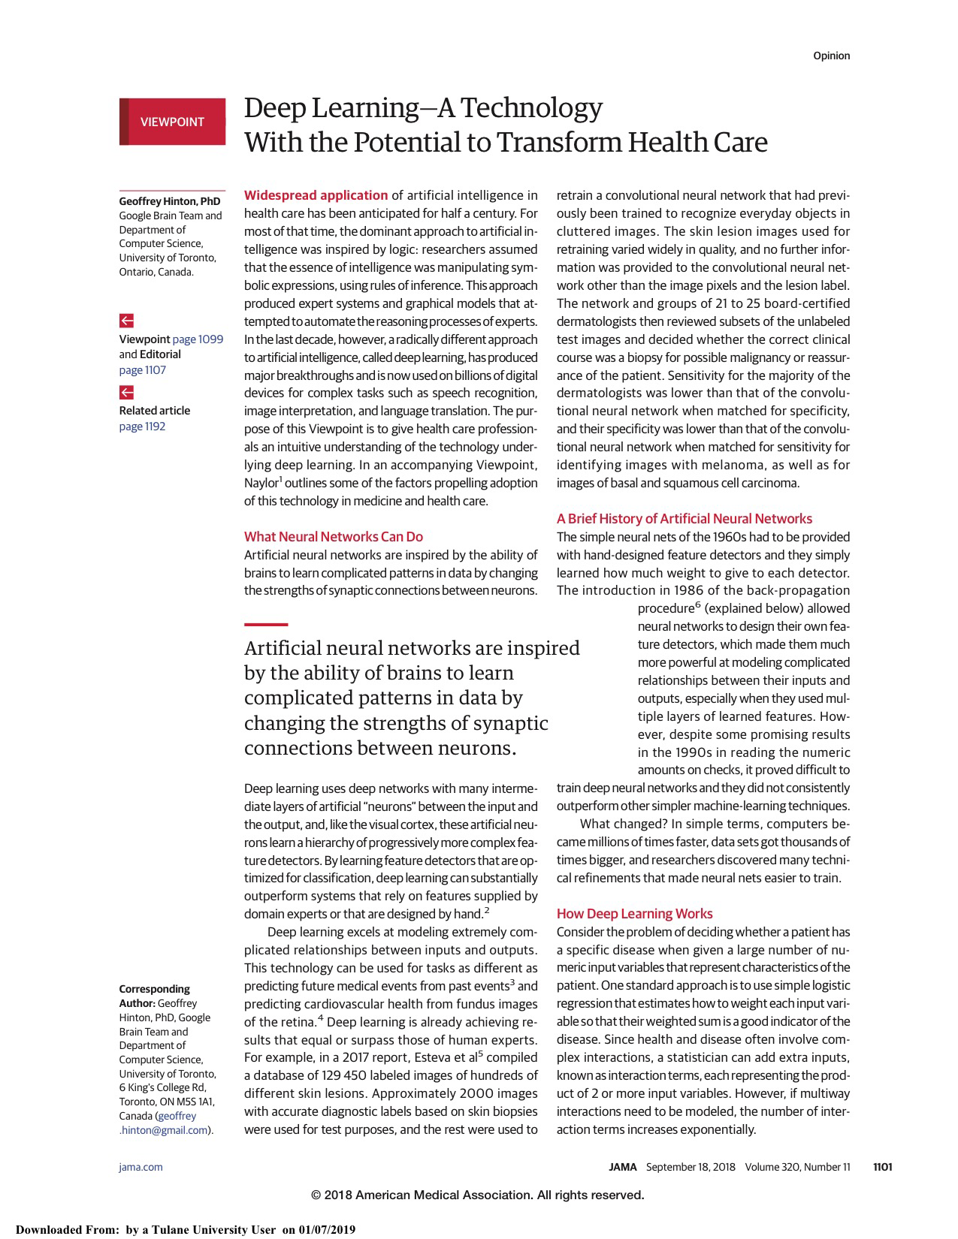
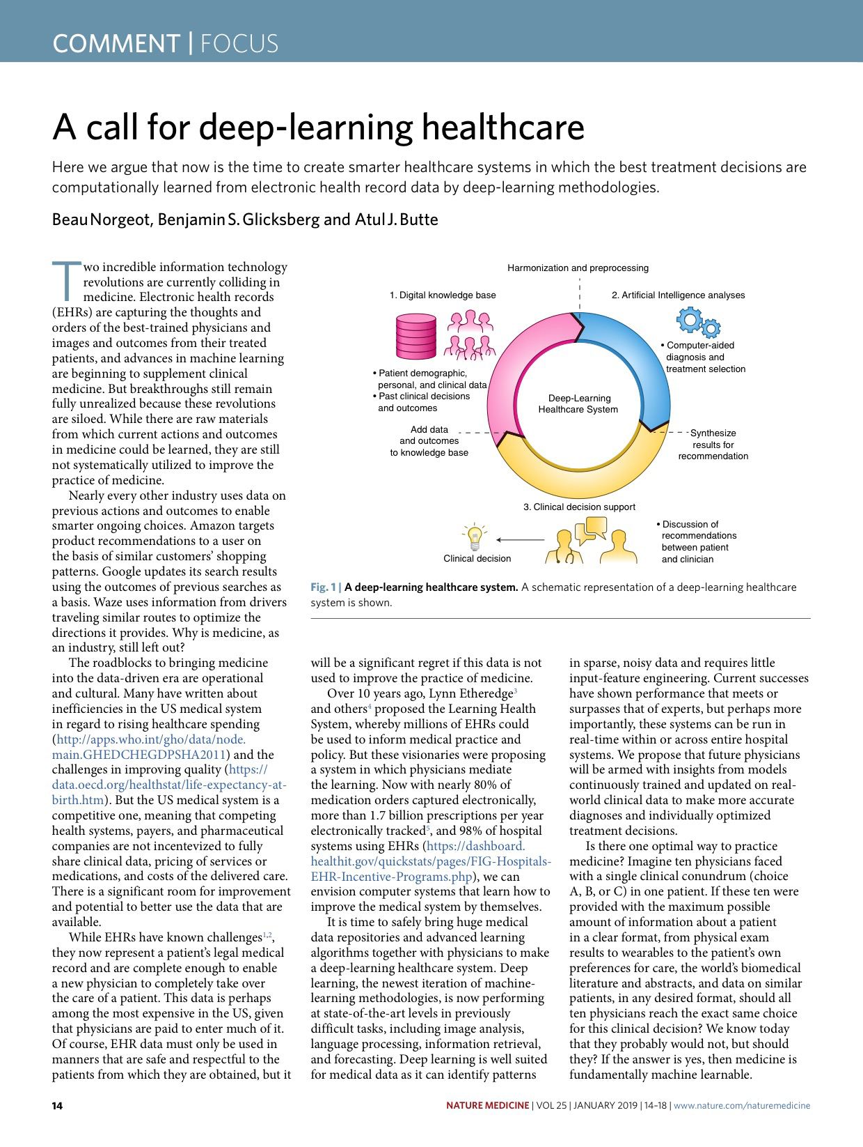
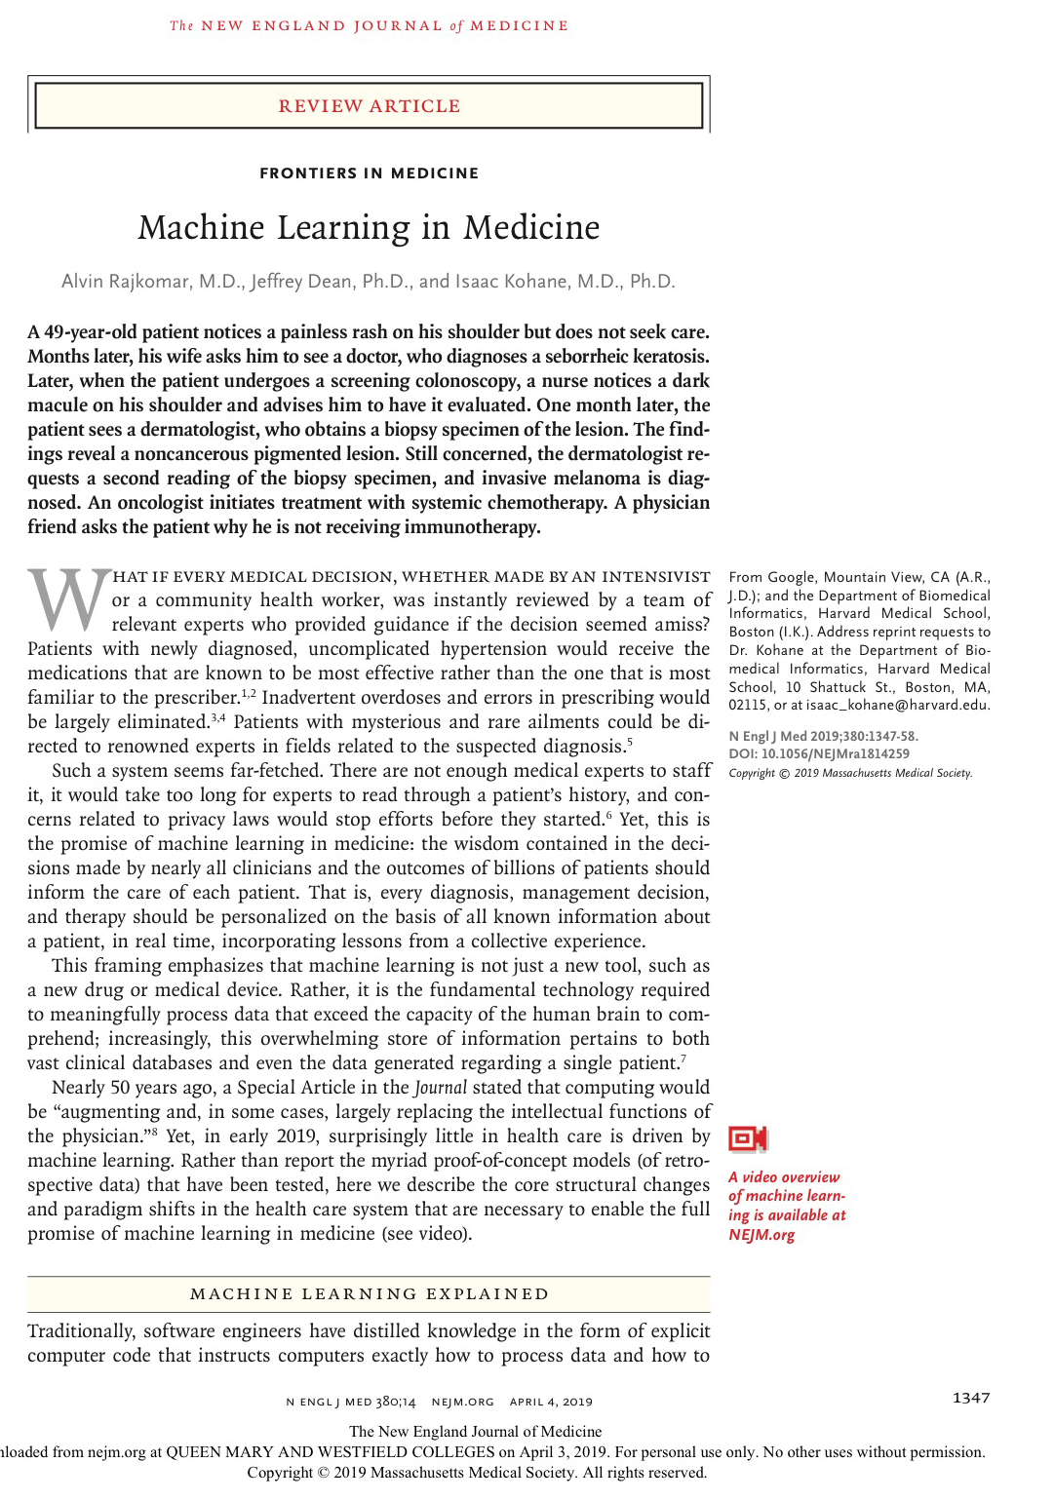
What is different about “modern” machine learning?
Comprehensive evaluation of learned models
Personal thoughts on machine learning + healthcare

Slide 3
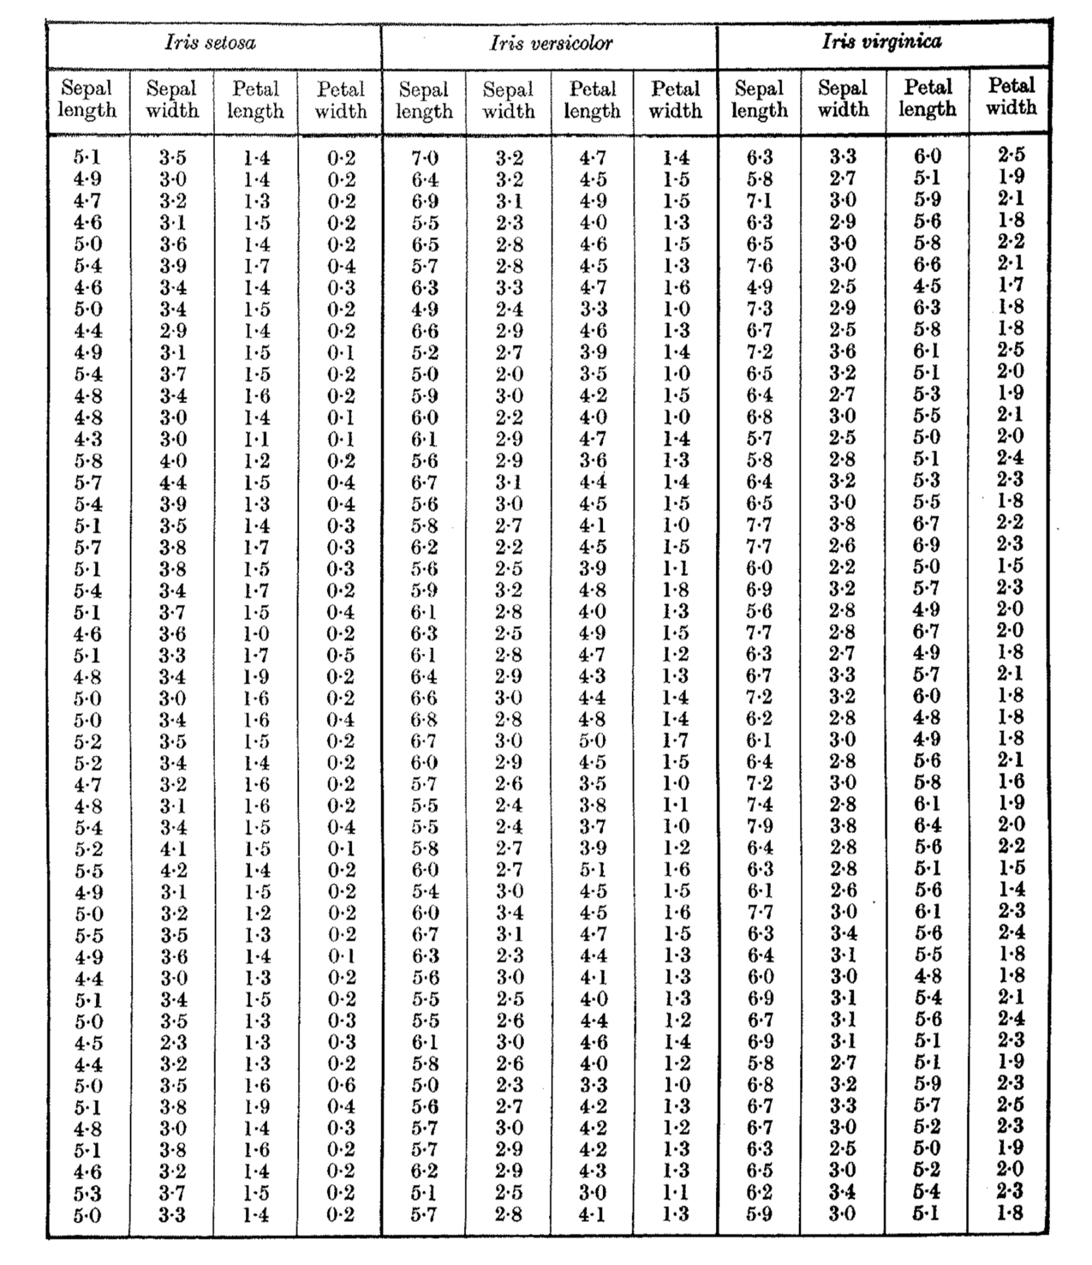
Fitting models to data, circa 1936
y (aka outputs, labels, responses, targets)
x₁
x₂
x₃
x₄
f(x) ≈ y
y ≈ h_{w}(x) = w₁x₁ + … + w₄x₄
small number of weights
(aka parameters)
x (aka inputs, features, covariates, attributes)

Slide 4
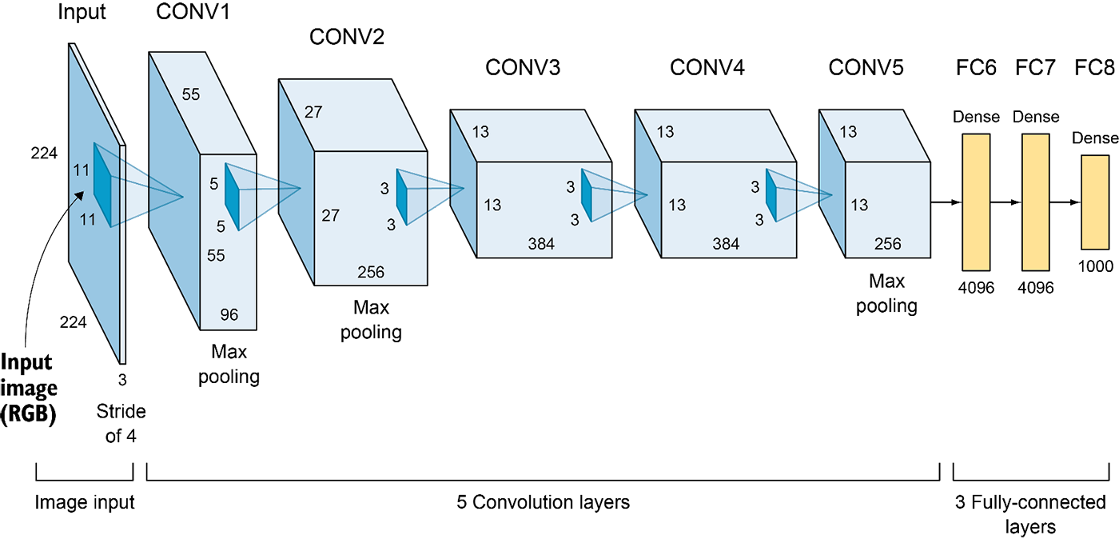
Fitting models to data, circa 2012
w
w
w
w
w
w
w
h_{w}( )
deep!
AlexNet has 62.3M parameters, trained on ∼1M images
overparametrized: more parameters than data

Slide 5
Gradient of loss
To get
y ≈ h_{w}(x)
(y - h_{w}(x))²
find w minimizing
loss function
-1 • tiny change to w which best minimizes loss
∇_{w} (y - h_{w}(x))²
= ∇_{w} (y - (w₁x₁ + … + w₄x₄))²
= -2 (y - (w₁x₁ + … + w₄x₄))w
Manually (for small model)
??? (for large model)
∇_{w}
h_{w}( )

Slide 6



Automatic differentiation software for ∇_{w}
If you can code it, you can optimize it.
(Or at least try.)
But just because we can use large models don’t mean we should…

Slide 7
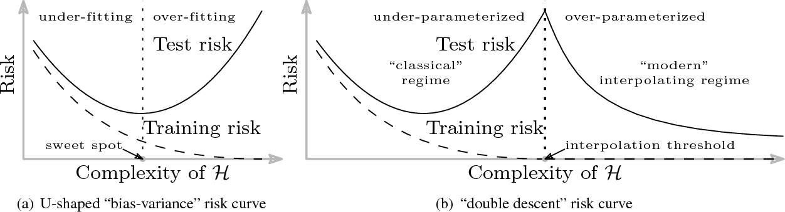
Large models stumbled upon the double-descent phenomenon!
Error
Test
Train
Number of parameters
[Belkin et al., 2019]

Slide 8
What is different about “modern” machine learning?
Comprehensive evaluation of learned models
Bigger models, enabled by automatic differentiation software and faster computers, enjoy “second descent” of error, side-stepping classical concerns about overfitting.

Slide 9
(Test) Accuracy
x
Development
⇒
Large models exposed flaws of focusing solely on accuracy during development.
Real-world use
(Real) Accuracy
Robustness
Fairness
Accountability

Slide 10
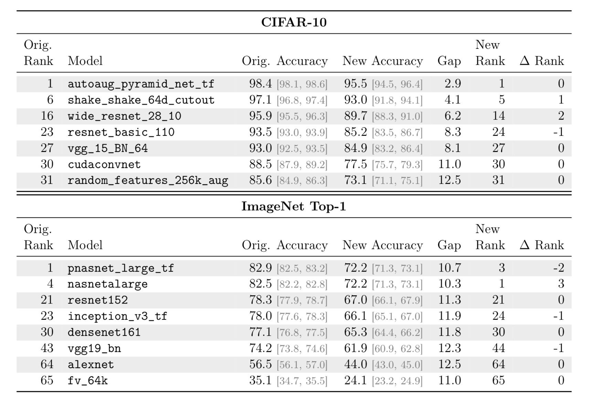
Replicating the test set (“real-world accuracy”)
Degradation for both smaller and larger models.
Hard to estimate the amount of degradation prior to replication.
[Recht et al., 2019]

Slide 11
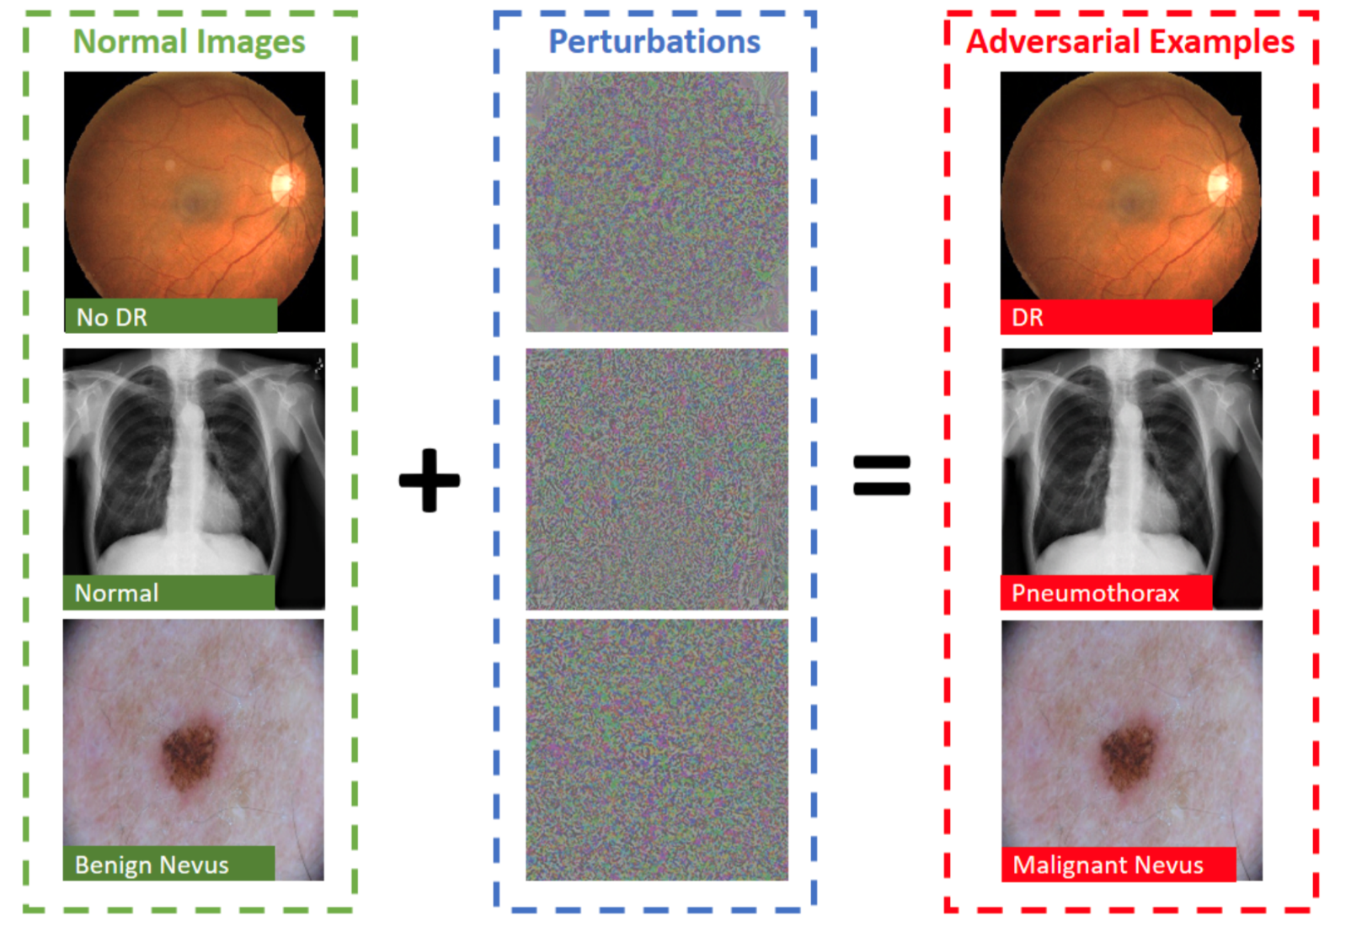
Test-accuracy does not imply robustness.
Junk, exploiting a bug in the model?
An actual (though non-robust) pattern in the dataset?
[Ma et al., 2019]
Higher test-accuracy may reduce robustness!
[Tsipras, et al., 2019]

Slide 12
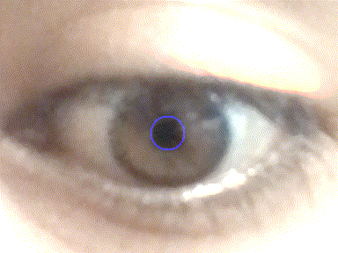
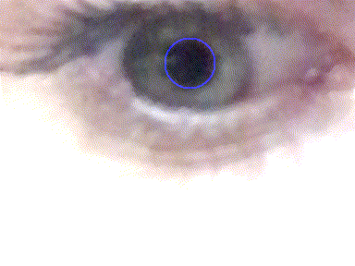

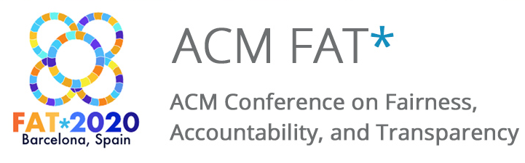
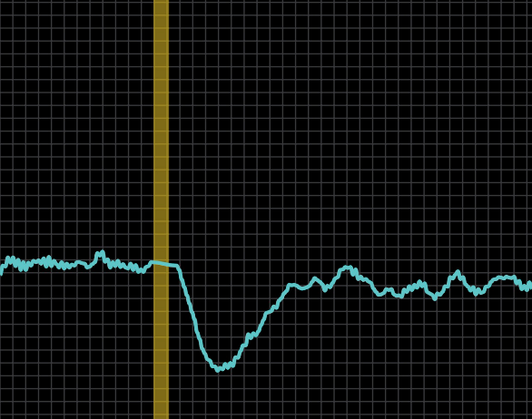
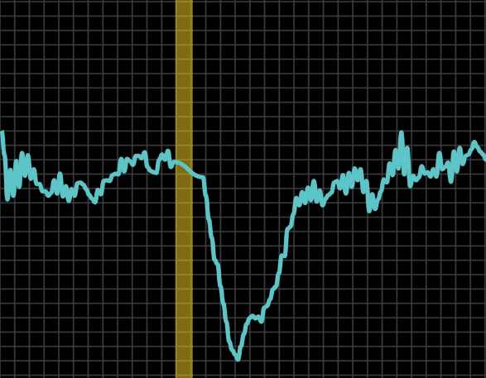
Fairness may be at odds with accuracy.
Pupillary light response reveals nervous system state…
What does it even mean?)
Don’t reinvent the wheel!
…better on blue and green eyes than brown ones?

Slide 13
What is different about “modern” machine learning?
Comprehensive evaluation of learned models
Personal thoughts on machine learning + healthcare
Bigger models, enabled by automatic differentiation software and faster computers, enjoy “second descent” of error, side-stepping classical concerns about overfitting.
Test accuracy is not necessarily representative of real-world accuracy, nor does it subsume all desirable characteristics of a model (such as robustness and fairness).

Slide 14
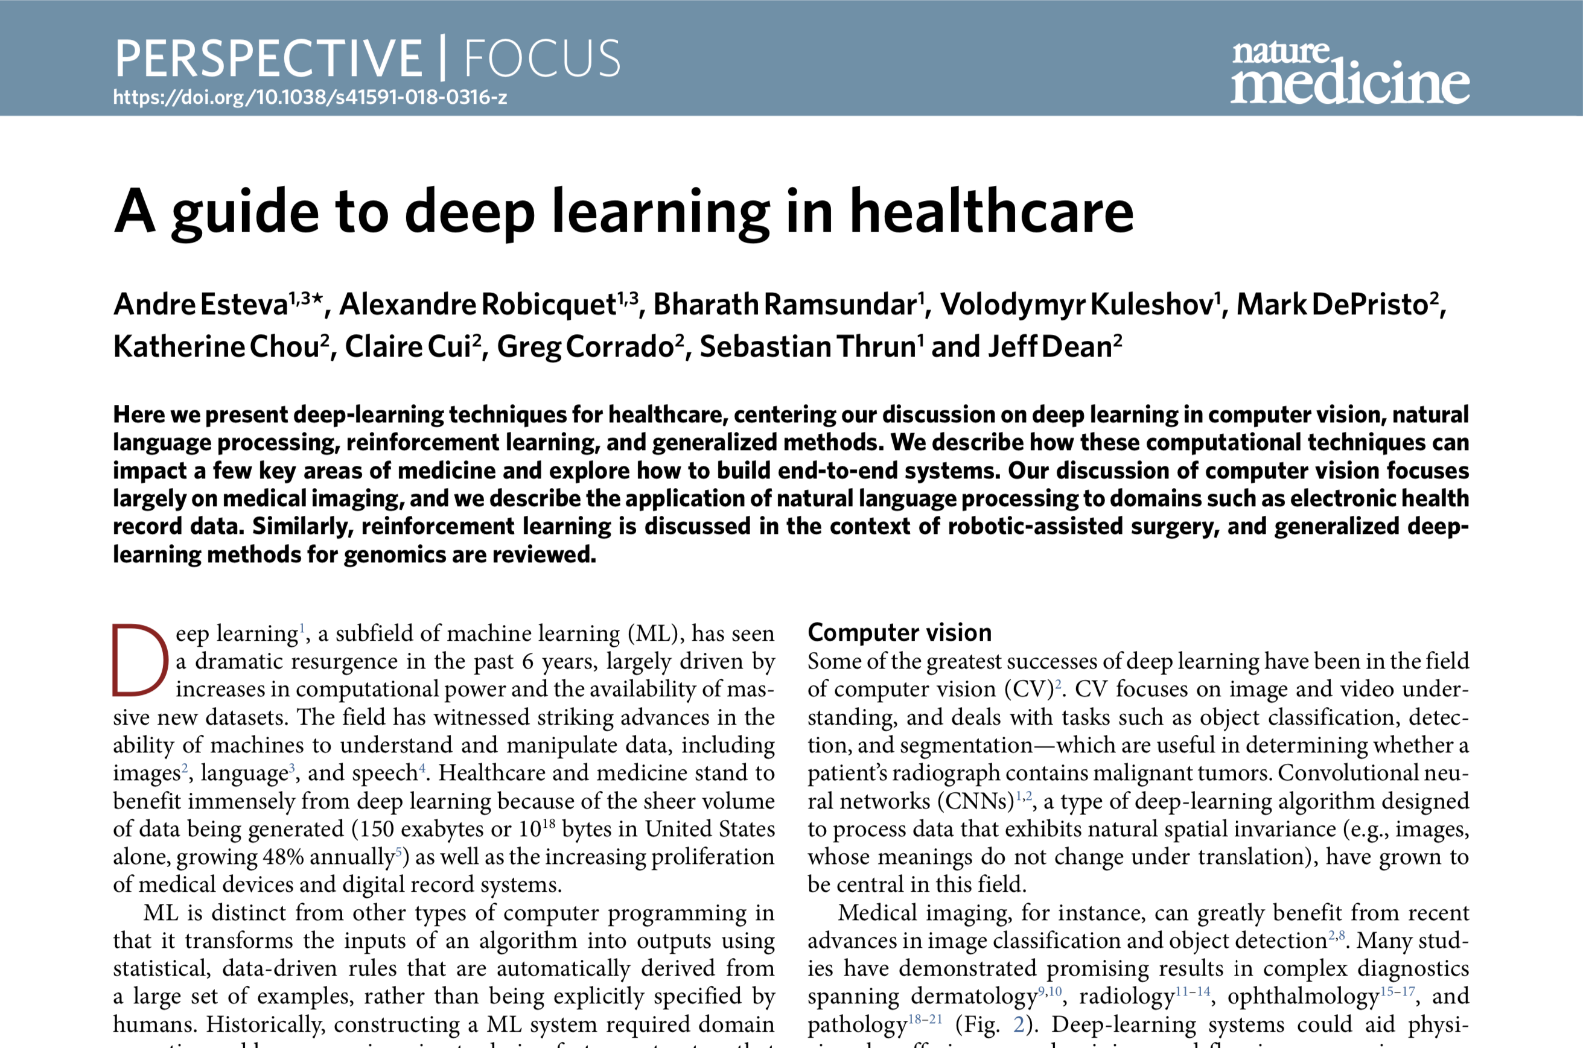
replacing doctors

Slide 15

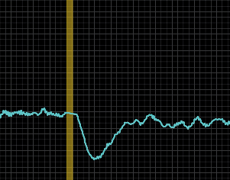
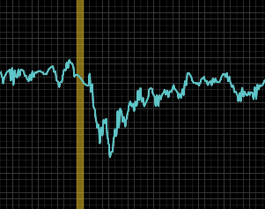
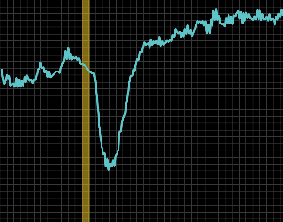
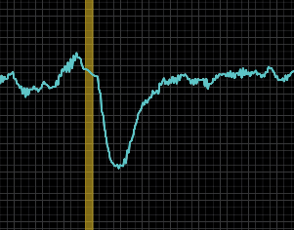
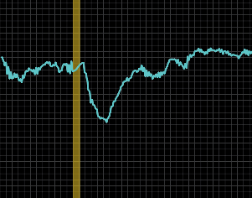
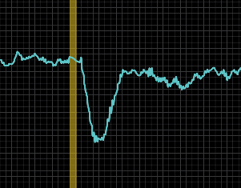

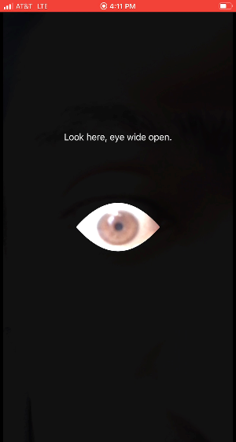
Algorithm makes lots of inexpensive decisions
Formal machine learning approach can avoid human statistical blunders
Data collected outside traditional healthcare environment, with new sensors and algorithms

Slide 16
What is different about “modern” machine learning?
Comprehensive evaluation of learned models
Personal thoughts on machine learning + healthcare
Bigger models, enabled by automatic differentiation software and faster computers, enjoy “second descent” of error, side-stepping classical concerns about overfitting.
Test accuracy is not necessarily representative of real-world accuracy, nor does it subsume all desirable characteristics of a model (such as robustness and fairness).
Machine learning won’t just “replace doctors”, it will change the way healthcare works.

Slide 17
References
Belkin, Mikhail, et al. "Reconciling modern machine-learning practice and the classical bias–variance trade-off." Proceedings of the National Academy of Sciences 116.32 (2019): 15849-15854.
Kaul, Shiva. “Speed and Accuracy are not Enough! Trustworthy Machine Learning.” AEIS Conference. 2018.
Recht, Benjamin, et al. "Do ImageNet Classifiers Generalize to ImageNet?." International Conference on Machine Learning. 2019.
Ma, Xingjun, et al. "Understanding Adversarial Attacks on Deep Learning Based Medical Image Analysis Systems." arXiv preprint arXiv:1907.10456 (2019).
Tsipras, et al. “Robustness May Be at Odds with Accuracy”. International Conference on Learning Representations. 2019.
Esteva, Andre, et al. "A guide to deep learning in healthcare." Nature medicine 25.1 (2019): 24-29.

